Slide 1
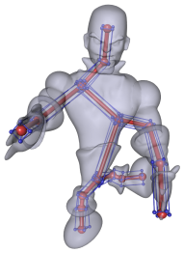
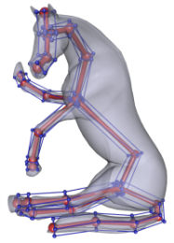

Pseudo-Skeleton based ARAP Mesh Deformation
M. Zollhöfer, A. Vieweg, J. Süßmuth and G. Greiner
Computer Graphics Group, FAU Erlangen-Nuremberg, Germany

Slide 2
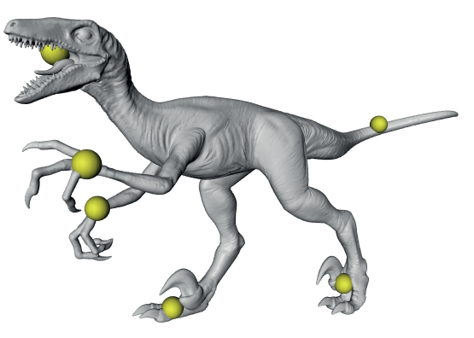

Motivation/Requirements
Intuitive modeling
  Handle-based
  Direct manipulation
  CASA 2013 – Short Paper

Slide 3
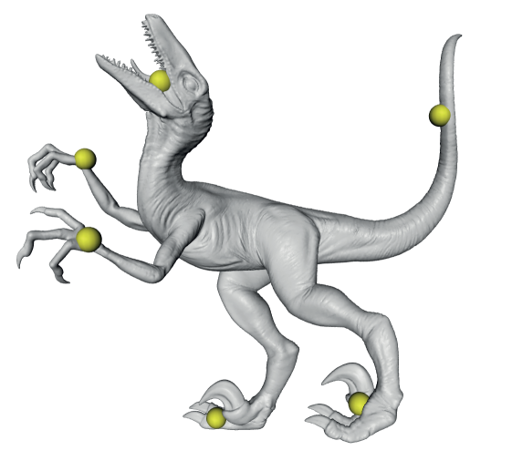
Motivation/Requirements
Intuitive modeling
  Handle-based
  Direct manipulation
Interactivity
  Even for high quality models
  CASA 2013 – Short Paper

Slide 4
Motivation/Requirements
Intuitive modeling
  Handle-based
  Direct manipulation
Interactivity
  Even for high quality models
Physical plausibility
  Globally smooth deformations
  CASA 2013 – Short Paper

Slide 5
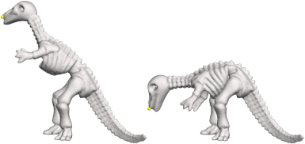
Related Work
ARAP Surface Modeling
[SA07]
  CASA 2013 – Short Paper

Slide 6
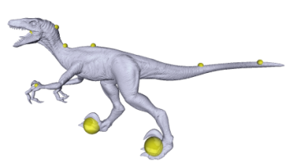
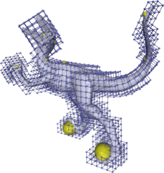
Related Work
ARAP Surface Modeling
GPU based Volumetric ARAP
[SA07]
[ZSGS12]
  CASA 2013 – Short Paper

Slide 7
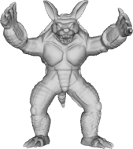
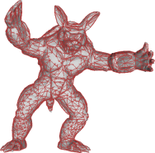
Related Work
ARAP Surface Modeling
GPU based Volumetric ARAP
Hybrid Mesh Editing
[SA07]
[ZSGS12]
[BHZN10]
  CASA 2013 – Short Paper

Slide 8
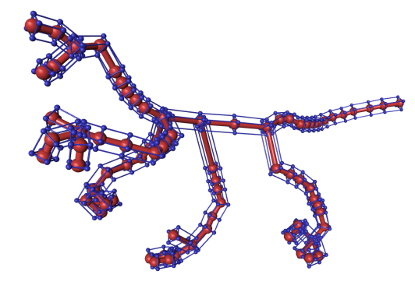
Facts/Contribution
Method
  Based on the non-linear ARAP energy [SA07]
  Pseudo Skeleton based proxy geometry
  Bones are allowed to stretch and twist
  CASA 2013 – Short Paper

Slide 9
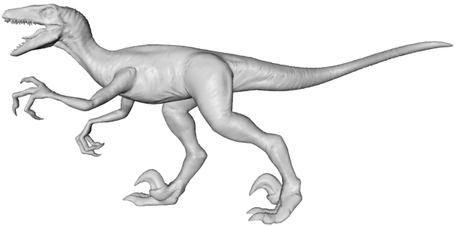
Facts/Contribution
Method
  Based on the non-linear ARAP energy [SA07]
  Pseudo Skeleton based proxy geometry
  Bones are allowed to stretch and twist
Benefits
  The optimization is decoupled from the model’s geometric complexity
  Fast even for high quality models
  Easy to integrate into existing systems
  CASA 2013 – Short Paper

Slide 10

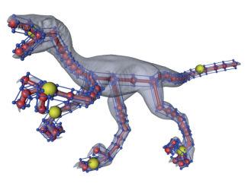
Overview
Preprocessing
  Automatically create pseudo skeleton
    Decouple problem from model complexity
    Transparent for the user
  CASA 2013 – Short Paper

Slide 11
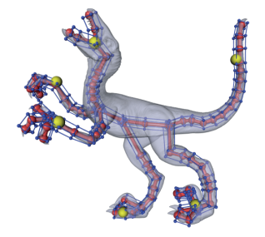

Overview
Preprocessing
  Automatically create pseudo skeleton
    Decouple problem from model complexity
    Transparent for the user
Runtime
  Modify handle positions
  Use ARAP solver to deform pseudo skeleton
  Transfer deformation to input model
  CASA 2013 – Short Paper

Slide 12
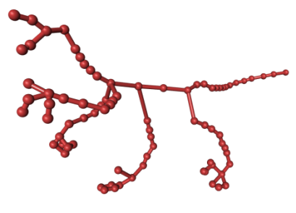
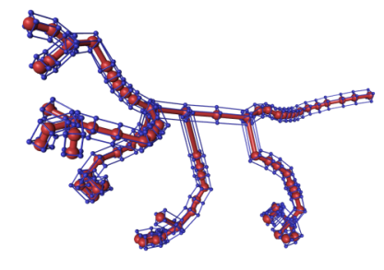
Proxy Geometry
Pseudo Skeleton
  Skeleton
    Mesh Contraction [ACCTL08]
  Skinning weights
    Diffusion based [BP07]
  Add Pseudo bones
    Local rotations under-determined
  CASA 2013 – Short Paper

Slide 13
Proxy Geometry
Pseudo Skeleton
  Skeleton
    Mesh Contraction [ACCTL08]
  Skinning weights
    Diffusion based [BP07]
  Add Pseudo bones
    Local rotations under-determined
Bone to vertex mapping
  Linear Blend Skinning (LBS)
  CASA 2013 – Short Paper

Slide 14
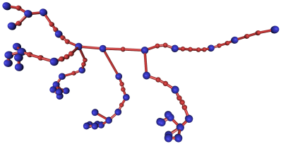
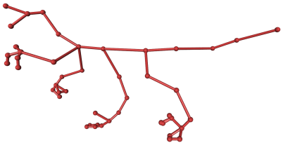
Proxy Geometry
Pseudo Skeleton
  Skeleton
    Mesh Contraction [ACCTL08]
  Skinning weights
    Diffusion based [BP07]
  Add Pseudo bones
    Local rotations under-determined
Bone to vertex mapping
  Linear Blend Skinning (LBS)
Adjust skeleton complexity
  Only keep neccessary DoFs
  CASA 2013 – Short Paper

Slide 15
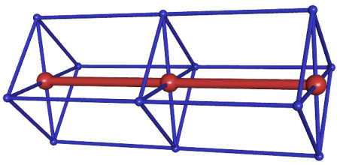


Optimization Problem
$$n_{j}$$
Paradigm
  ARAP [SA07] on a Pseudo Skeleton
$$n_{i}$$
  CASA 2013 – Short Paper

Slide 16
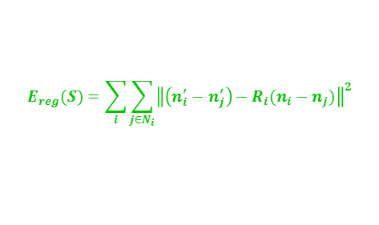
Optimization Problem
$$n_{j}$$
Paradigm
  ARAP [SA07] on a Pseudo Skeleton
  Objective function
    Plausibility of deformation
      Rigidity of local transformations
$$n_{i}$$
$$E_{reg}(S)=\sum_{i}{\sum_{j∈N_{i}}{{\left\|\left(n_{i}^{′}−n_{j}^{′}\right)−R_{i}(n_{i}−n_{j})\right\|}^{2}}}$$
  CASA 2013 – Short Paper

Slide 17
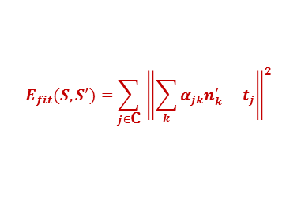
Optimization Problem
$$n_{j}$$
Paradigm
  ARAP [SA07] on a Pseudo Skeleton
  Objective function
    Plausibility of deformation
      Rigidity of local transformations
    Fulfillment of user constraints
      Distance between vertices and handles
$$n_{i}$$
$$E_{reg}(S)=\sum_{i}{\sum_{j∈N_{i}}{{\left\|\left(n_{i}^{′}−n_{j}^{′}\right)−R_{i}(n_{i}−n_{j})\right\|}^{2}}}$$
$$E_{fit}(S, S^{′})={\sum_{j∈\text{C}}{ \left\|\sum_{k}{α_{jk}n_{k}^{′}−t_{j}}\right\|}}^{2}$$
  CASA 2013 – Short Paper

Slide 18
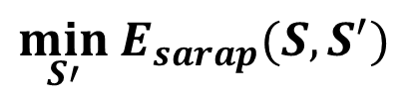
Optimization Problem
$$n_{j}$$
Paradigm
  ARAP [SA07] on a Pseudo Skeleton
  Objective function
    Plausibility of deformation
      Rigidity of local transformations
    Fulfillment of user constraints
      Distance between vertices and handles
Non-linear optimization problem
$$n_{i}$$
$$E_{reg}(S)=\sum_{i}{\sum_{j∈N_{i}}{{\left\|\left(n_{i}^{′}−n_{j}^{′}\right)−R_{i}(n_{i}−n_{j})\right\|}^{2}}}$$
$$E_{fit}(S, S^{′})={\sum_{j∈\text{C}}{ \left\|\sum_{k}{α_{jk}n_{k}^{′}−t_{j}}\right\|}}^{2}$$
$$E_{sarap}\left(S,S^{′}\right)=γE_{reg}\left(S, S^{′}\right)+E_{fit}(S,S^{′})$$
$$\min_{S′}{E_{sarap}(S, S^{′})}$$
  CASA 2013 – Short Paper

Slide 19
Minimizing the Objective Function
Why do we use the ARAP paradigm?
  Non-linear rotation-aware objective function
  Minimization does not require a general-purpose non-linear solver
  CASA 2013 – Short Paper

Slide 20

Minimizing the Objective Function
Why do we use the ARAP paradigm?
  Non-linear rotation-aware objective function
  Minimization does not require a general-purpose non-linear solver
Iterative flip-flop solver [SA07]
  Compute optimal local rotations
    Local shape matching
  Compute new joint positions
    Linear System
$${\left(L+{α_{ }^{2}C}_{ }^{T}C\right)n^{′}=b+{αC}_{ }^{T}t}_{ }$$
  CASA 2013 – Short Paper

Slide 21
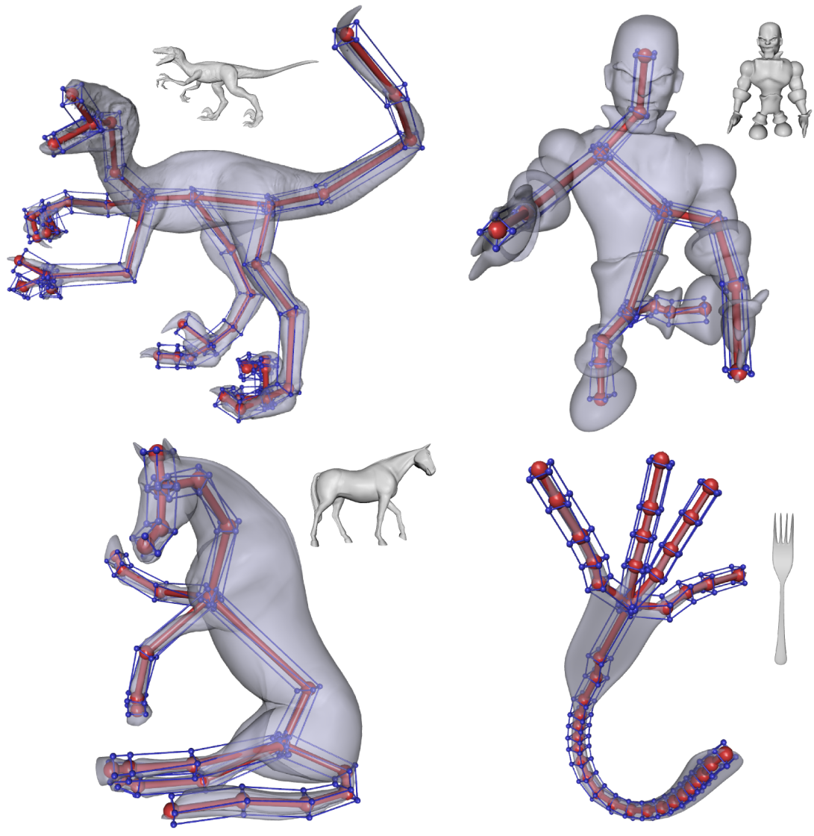
Results
  CASA 2013 – Short Paper

Slide 22
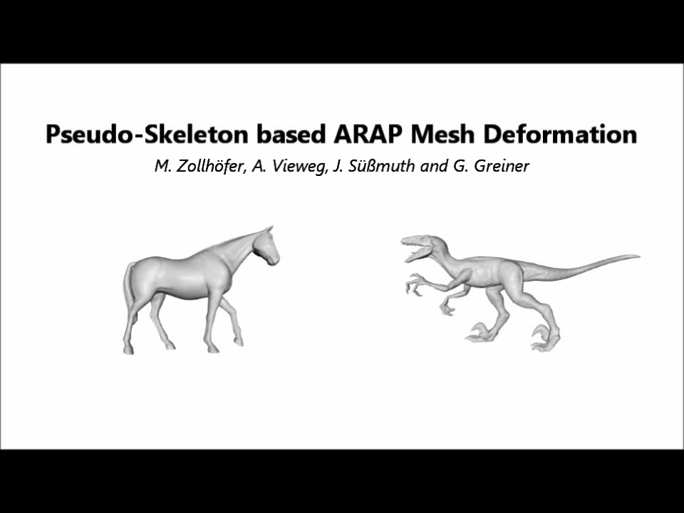
Video
  CASA 2013 – Short Paper

Slide 23
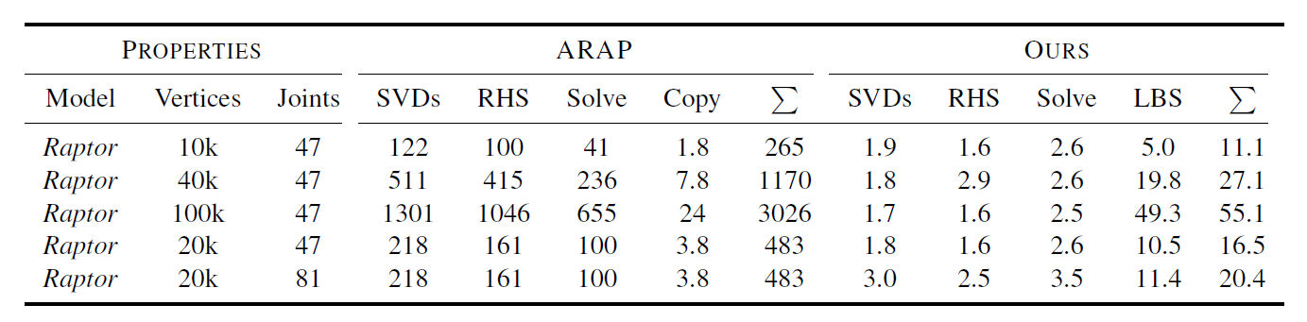
Facts
Evaluation
  Core2 Quad Q9450 CPU @2.66 GHz, NVidia GeForce GTX 285 GPU
  11.1ms to deform a 10k polygon model (47 joints)
  Pseudo geometry gives a 24x speedup compared to ARAP
    Most time spend in LBS
      Could be easily computed on the GPU
  CASA 2013 – Short Paper

Slide 24

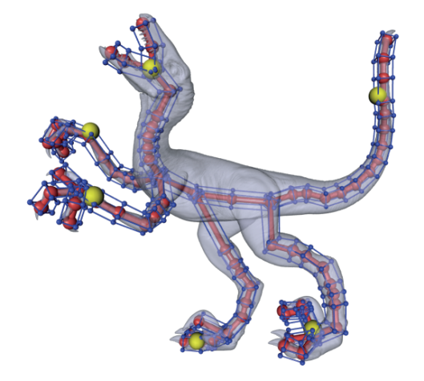
Conclusion
Summary
  Intuitive ARAP mesh editing paradigm using a simple pseudo skeleton
  CASA 2013 – Short Paper

Slide 25
Conclusion
Summary
  Intuitive ARAP mesh editing paradigm using a simple pseudo skeleton
Future Work
  Stretching resistance of bones
    Give artists more control
  Use more elaborate skinning techniques
    Rotations, twisting, stretching
  CASA 2013 – Short Paper

Slide 26
Questions?
Thanks for your attention!

