Slide 1
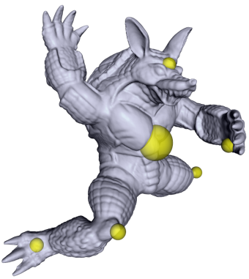
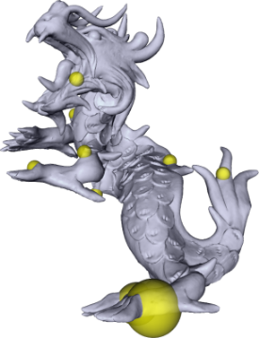

GPU based ARAP Deformation using Volumetric Lattices
M. Zollhöfer, E. Sert, G. Greiner and J. Süßmuth
Computer Graphics Group, University Erlangen-Nuremberg, Germany

Slide 2
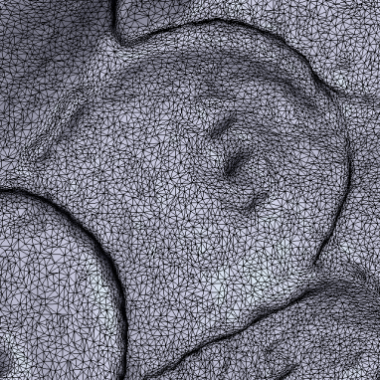
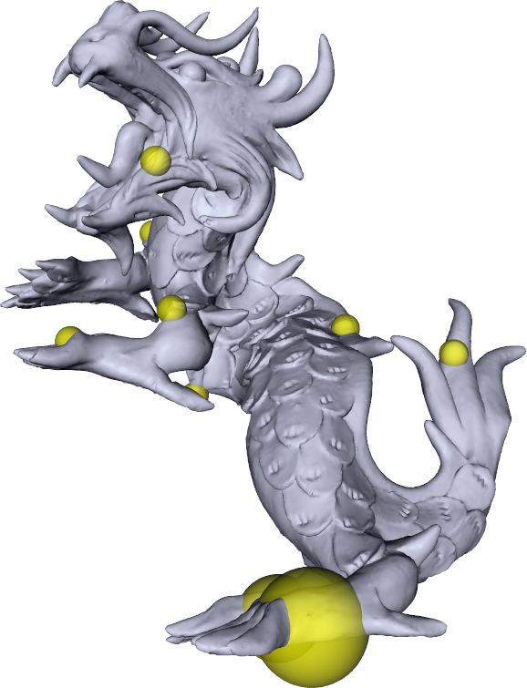

Motivation/Requirements
Intuitive modeling
  Handle-based
  Direct manipulation

Slide 3
Motivation/Requirements
Intuitive modeling
  Handle-based
  Direct manipulation
Interactivity
  Even for high quality models

Slide 4
Motivation/Requirements
Intuitive modeling
  Handle-based
  Direct manipulation
Interactivity
  Even for high quality models
Physical plausibility
  Globally smooth deformations
  Detail preservation

Slide 5
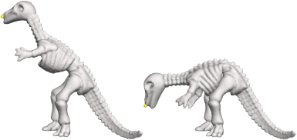
Recent Work
ARAP Surface Modeling
[SA07]

Slide 6
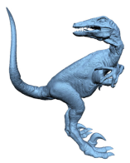
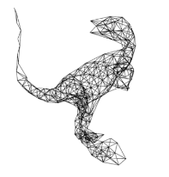
Recent Work
ARAP Surface Modeling
Deformation Graphs
[SA07]
[SSP07]

Slide 7
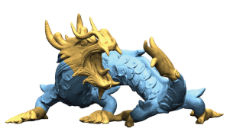
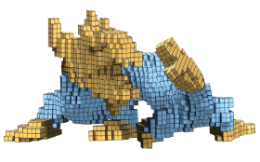
Recent Work
ARAP Surface Modeling
Deformation Graphs
Coupled Prisms/Rigid Cells
[SA07]
[SSP07]
[BPGK06,
BPWG07]

Slide 8
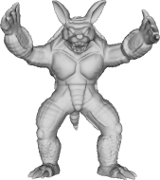
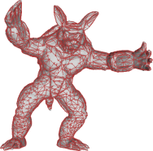
Recent Work
ARAP Surface Modeling
Deformation Graphs
Coupled Prisms/Rigid Cells
Hybrid Mesh Editing
[SA07]
[SSP07]
[BPGK06,
BPWG07]
[BHZN10]

Slide 9
Facts/Contribution
Method
  Based on the non-linear ARAP energy [SA07]
  Volumetric proxy geometry
  Multi-res GPU deformation pipeline

Slide 10
Facts/Contribution
Method
  Based on the non-linear ARAP energy [SA07]
  Volumetric proxy geometry
  Multi-res GPU deformation pipeline
Benefits
  The optimization is decoupled from the model’s geometric complexity
  Volume-awareness
  Fast even for high quality models
  Easy to integrate into existing systems

Slide 11
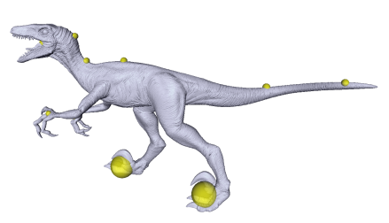
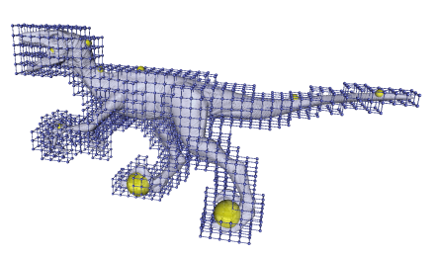
Overview
Preprocessing
  Construct volumetric lattice
    Decouples the optimization from the model’s geometric complexity
    Transparent for the user

Slide 12
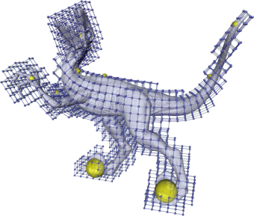
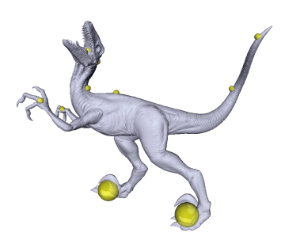
Overview
Preprocessing
  Construct volumetric lattice
    Decouples the optimization from the model’s geometric complexity
    Transparent for the user
Runtime loop
  Modify handle positions
  Deform lattice using our multi-res GPU ARAP solver
  Use lattice to deform the input model

Slide 13
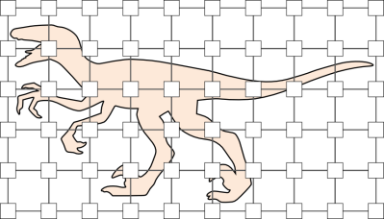
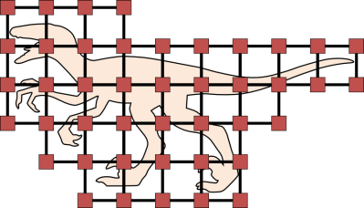
Proxy Geometry
Starting point
  Uniform voxel grid
  Delete cubes which are entirely outside
  Volumetric Lattice

Slide 14
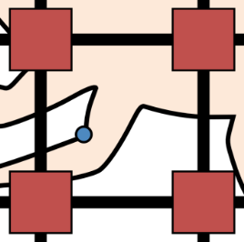

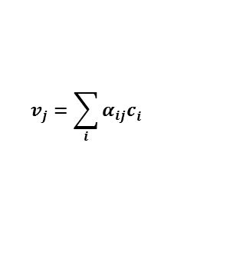
Proxy Geometry
Starting point
  Uniform voxel grid
  Delete cubes which are entirely outside
  Volumetric Lattice
Express vertices in local coordinates
  Interactive modeling
    Tri-linear interpolation
  Offline high quality poses
    B-Splines
$$v_{j}$$
$$v_{j}=\sum_{i}{α_{ij}c_{i}^{}}$$

Slide 15
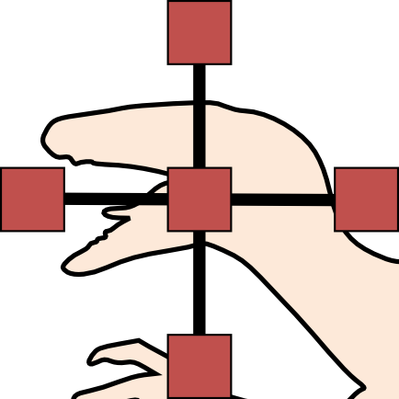


Optimization Problem
Paradigm
  ARAP [SA07] on a volumetric lattice
$$c_{i}$$
$$c_{j}$$

Slide 16
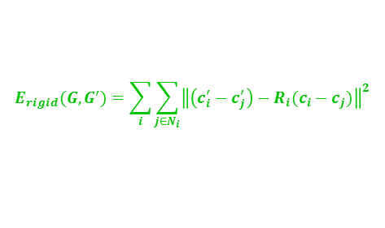
Optimization Problem
Paradigm
  ARAP [SA07] on a volumetric lattice
Objective function
  Plausibility of deformation
    Rigidity of local transformations
$$c_{i}$$
$$c_{j}$$
$$E_{rigid}(G, G^{′})=\sum_{i}{\sum_{j∈N_{i}}{{\left\|\left(c_{i}^{′}−c_{j}^{′}\right)−R_{i}(c_{i}−c_{j})\right\|}^{2}}}$$

Slide 17
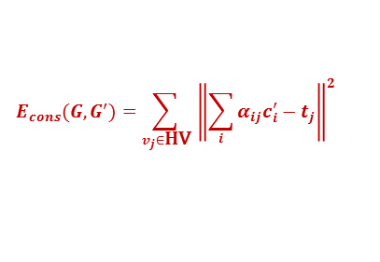
Optimization Problem
Paradigm
  ARAP [SA07] on a volumetric lattice
Objective function
  Plausibility of deformation
    Rigidity of local transformations
  Fulfillment of user constraints
    Distance of vertices to handles
$$c_{i}$$
$$c_{j}$$
$$E_{rigid}(G, G^{′})=\sum_{i}{\sum_{j∈N_{i}}{{\left\|\left(c_{i}^{′}−c_{j}^{′}\right)−R_{i}(c_{i}−c_{j})\right\|}^{2}}}$$
$$E_{cons}(G, G^{′})={\sum_{v_{j}∈\text{HV}}{ \left\|\sum_{i}{α_{ij}c_{i}^{′}−t_{j}}\right\|}}^{2}$$

Slide 18
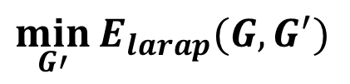
Optimization Problem
Paradigm
  ARAP [SA07] on a volumetric lattice
Objective function
  Plausibility of deformation
    Rigidity of local transformations
  Fulfillment of user constraints
    Distance of vertices to handles
Non-linear optimization
$$c_{i}$$
$$c_{j}$$
$$E_{rigid}(G, G^{′})=\sum_{i}{\sum_{j∈N_{i}}{{\left\|\left(c_{i}^{′}−c_{j}^{′}\right)−R_{i}(c_{i}−c_{j})\right\|}^{2}}}$$
$$E_{cons}(G, G^{′})={\sum_{v_{j}∈\text{HV}}{ \left\|\sum_{i}{α_{ij}c_{i}^{′}−t_{j}}\right\|}}^{2}$$
$$E_{larap}\left(G, G^{′}\right)=γE_{rigid}\left(G, G^{′}\right)+E_{cons}(G,G^{′})$$
$$\min_{G′}{E_{larap}(G, G^{′})}$$

Slide 19
Minimizing the Objective Function
Why do we use the ARAP paradigm?
  Non-linear rotation-aware objective function
  Minimization does not require a general-purpose non-linear solver

Slide 20
Minimizing the Objective Function
Why do we use the ARAP paradigm?
  Non-linear rotation-aware objective function
  Minimization does not require a general-purpose non-linear solver
Iterative flip-flop solver [SA07]
  Compute optimal local rotations
    SVDs are independent
  Compute new control points
    Iterative linear solver

Slide 21
Minimizing the Objective Function
Why do we use the ARAP paradigm?
  Non-linear rotation-aware objective function
  Minimization does not require a general-purpose non-linear solver
Iterative flip-flop solver [SA07]
  Compute optimal local rotations
    SVDs are independent
  Compute new control points
    Iterative linear solver
Massively parallel GPU implementation

Slide 22
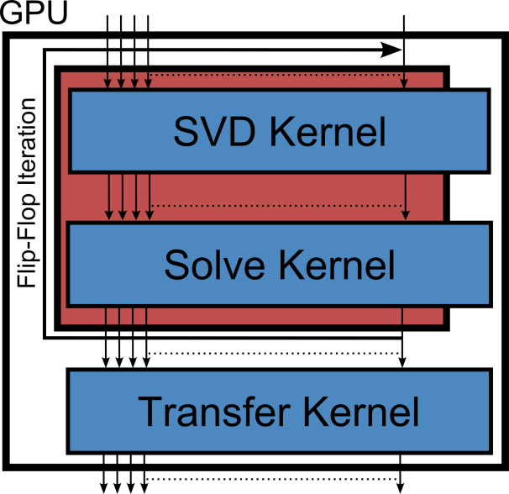
GPU Deformation Pipeline
CUDA Implementation
  SVD Kernel (per control point)

Slide 23
GPU Deformation Pipeline
CUDA Implementation
  SVD Kernel (per control point)
  Solve Kernel (per control point)
    Parallel Gauss-Seidel solver or gradient descent
    Use new positions ASAP

Slide 24
GPU Deformation Pipeline
CUDA Implementation
  SVD Kernel (per control point)
  Solve Kernel (per control point)
    Parallel Gauss-Seidel solver or gradient descent
    Use new positions ASAP
  Transfer Kernel (per vertex)

Slide 25
GPU Deformation Pipeline
CUDA Implementation
  SVD Kernel (per control point)
  Solve Kernel (per control point)
    Parallel Gauss-Seidel solver or gradient descent
    Use new positions ASAP
  Transfer Kernel (per vertex)
  Synchronize between kernel calls

Slide 26
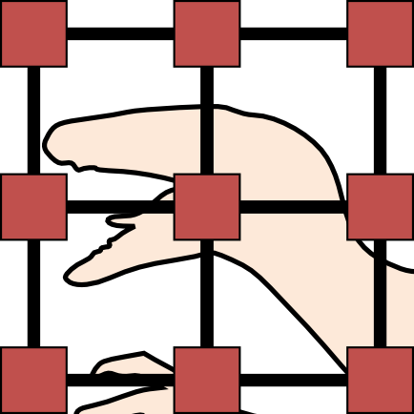
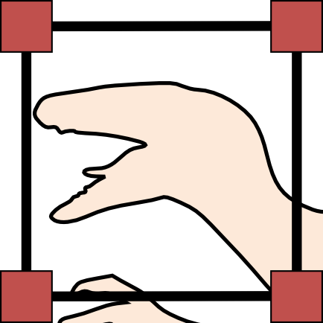
Multi-res GPU Deformation Pipeline
New Proxy Geometry
  Hierarchy of lattices
    Join 8 adjacent cubes
    Encode lattices w.r.t. the next coarser one
Level 0
Level 1
…

Slide 27
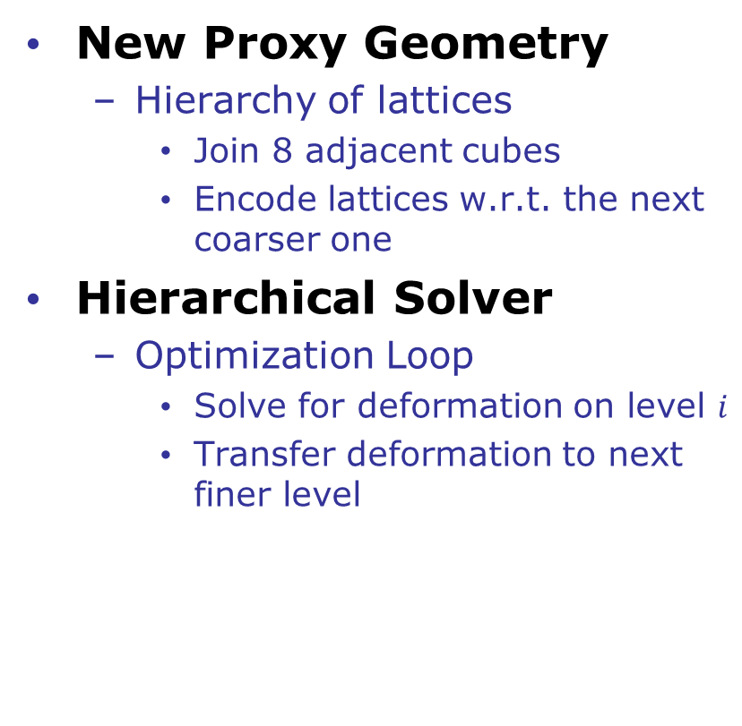
Multi-res GPU Deformation Pipeline
New Proxy Geometry
  Hierarchy of lattices
    Join 8 adjacent cubes
    Encode lattices w.r.t. the next coarser one
Hierarchical Solver
  Optimization Loop
    Solve for deformation on level $i$
    Transfer deformation to next finer level
Level 0
Level 1
…

Slide 28
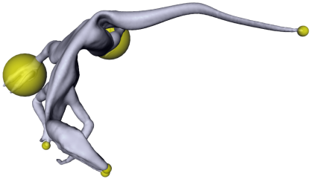
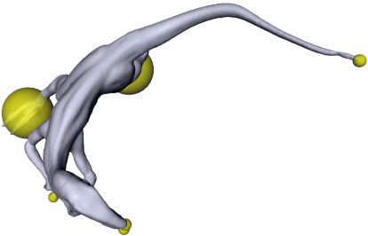
Results/Properties
Volume-awareness
ARAP
Ours

Slide 29
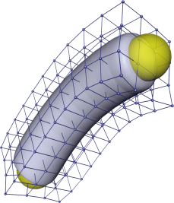
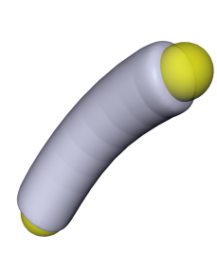

Results/Properties
Volume-awareness
Smoothness
ARAP
Ours
Tri-linear
B-Spline

Slide 30

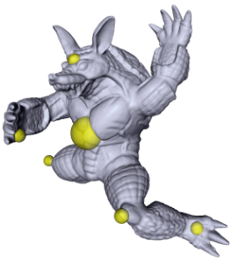
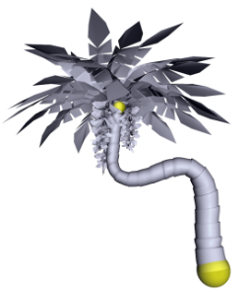
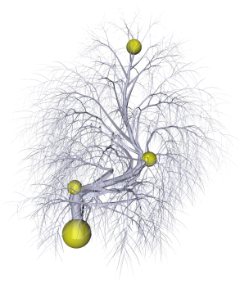
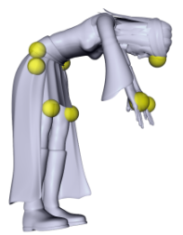
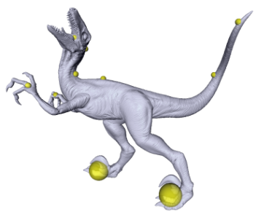
Facts
Evaluation
  Core i7 860 CPU with an NVidia GeForce 580 GPU
  71ms (14fps) to deform a 2M polygon model (40k lattice)
Triangle Mesh
Triangle Mesh
Polygon Soup
Multiple Components
Polygon Soup
Triangle Mesh

Slide 31
Facts
Evaluation
  Core i7 860 CPU with an NVidia GeForce 580 GPU
  71ms (14fps) to deform a 2M polygon model (40k lattice)
  Multi-res solver gives a 3x speedup compared to the single level version
    Less iterations per hierarchy level required to converge
Triangle Mesh
Triangle Mesh
Polygon Soup
Multiple Components
Polygon Soup
Triangle Mesh

Slide 32
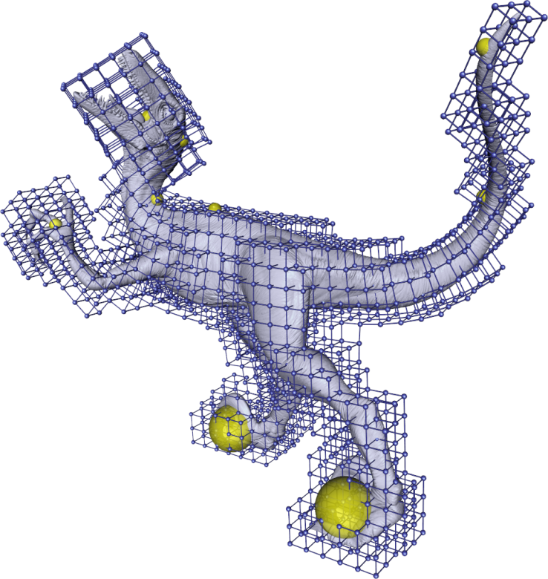
Conclusion
Summary
  Intuitive mesh editing paradigm using a simple volumetric lattice
  Data-parallel multi-res GPU deformation pipeline

Slide 33
Conclusion
Summary
  Intuitive mesh editing paradigm using a simple volumetric lattice
  Data-parallel multi-res GPU deformation pipeline
Future Work
  Construct lattice hierarchy in a topology preserving way
  Monitor deformation error to solve the optimization problem locally up to a given threshold

Slide 34
Questions?
Thanks for your attention!

