Slide 1
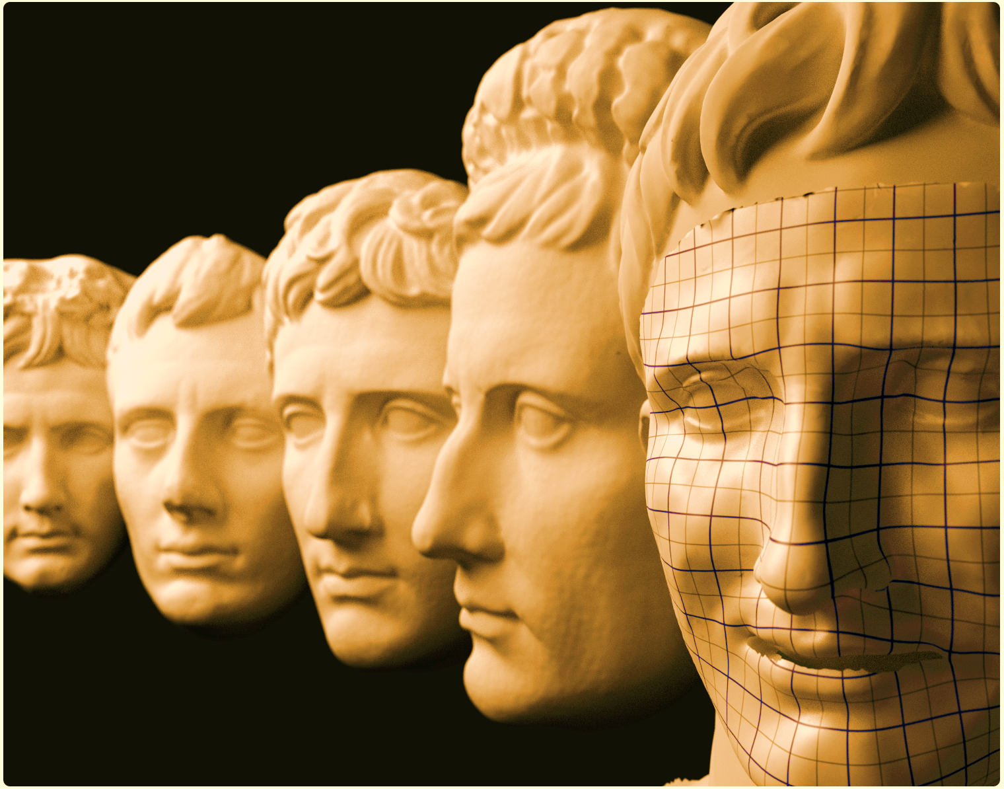


Visualization and Deformation Techniques for
Entertainment and Training
in Cultural Heritage
M. Zollhöfer, J. Süßmuth, F. Bauer, M. Stamminger M. Boss
Computer Graphics Group, FAU Erlangen-Nuremberg Classical Archeology, FAU Erlangen-Nuremberg
8th International Symposium on Image and Signal Processing and Analysis (ISPA 2013)
September 4-6, 2013, Trieste,Italy

Slide 2
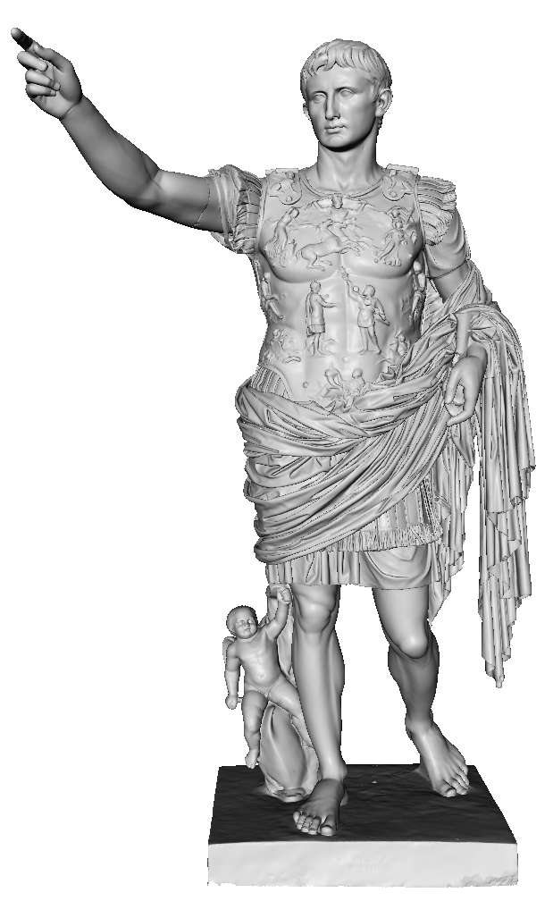
Overview
Motivation
Building Blocks
  Acquisition and Reconstruction
  Rigid and Non-Rigid Registration
  Statistical Face Model
Applications
  Virtual Painting
  Visualizing Differences in Busts
  Virtual Restoration of Artefacts
  Augustification/Animation Retargeting
Conclusion/Future Work
Breuckmann GmbH

Slide 3
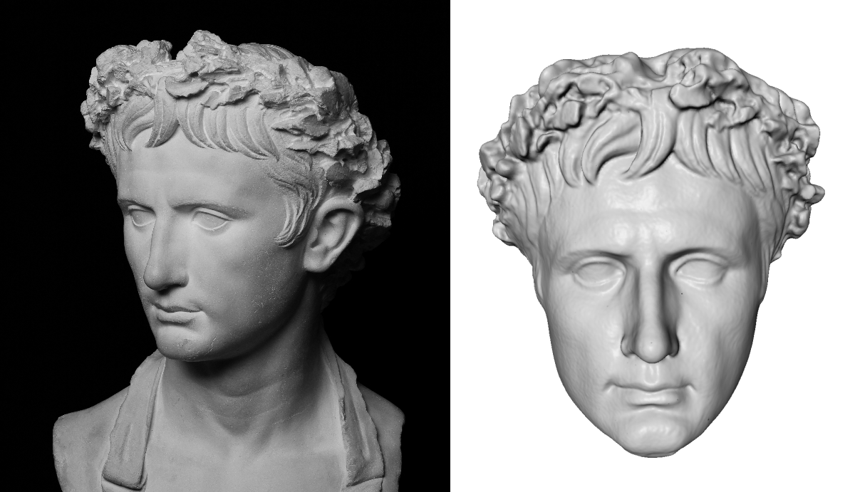
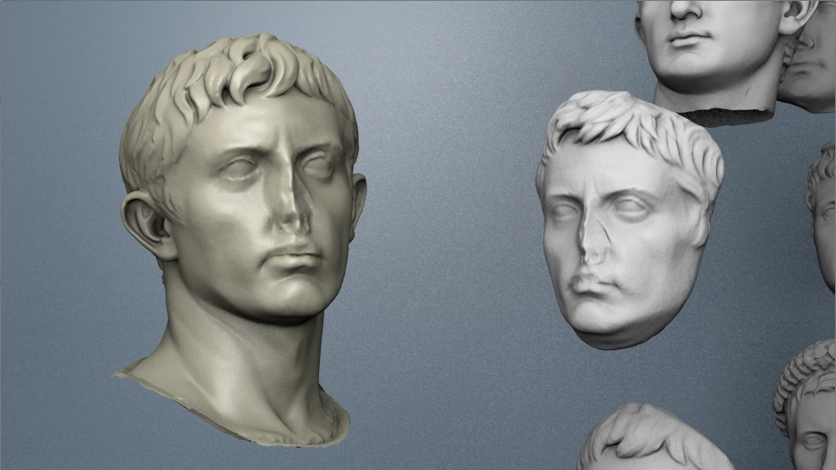
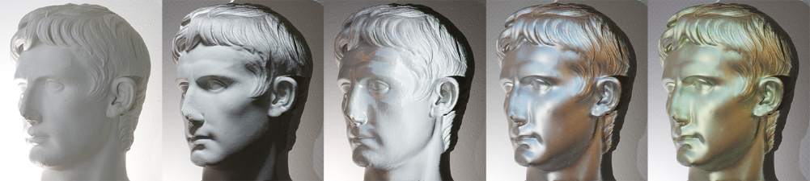
Motivation
Conservation and Analysis:
  Knowledge shapes understanding of history
  Preserve knowledge for future generations
Communicate knowledge by means of entertainment/visualization
  More accessible to the general public
  Combine Humanities with Computer Graphics

Slide 4
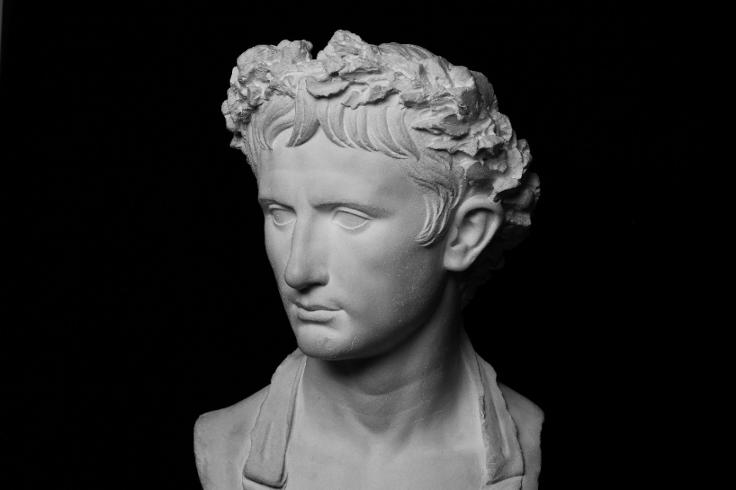
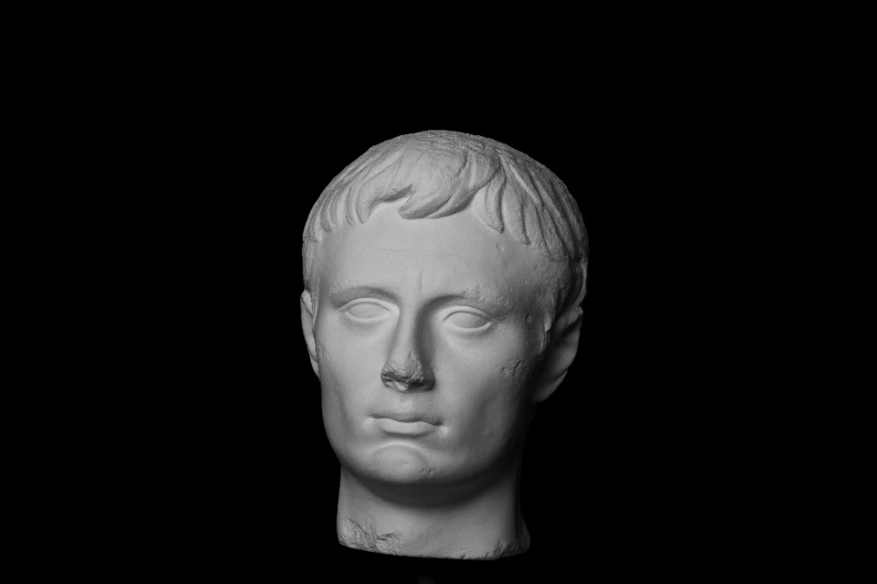
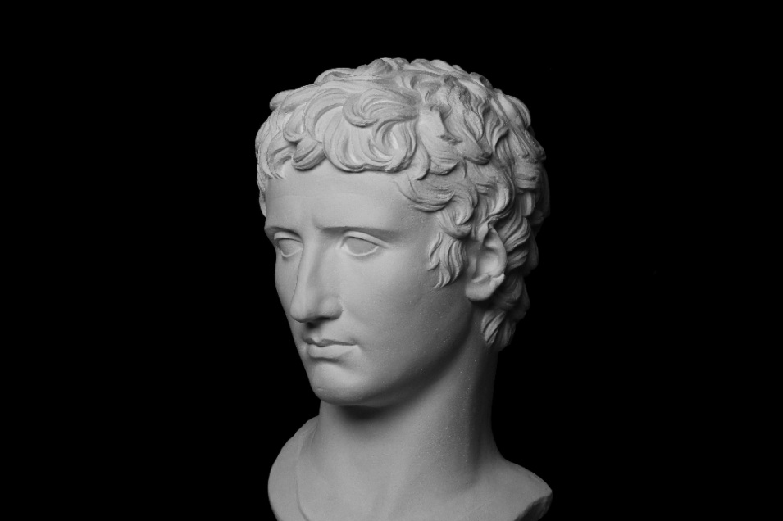
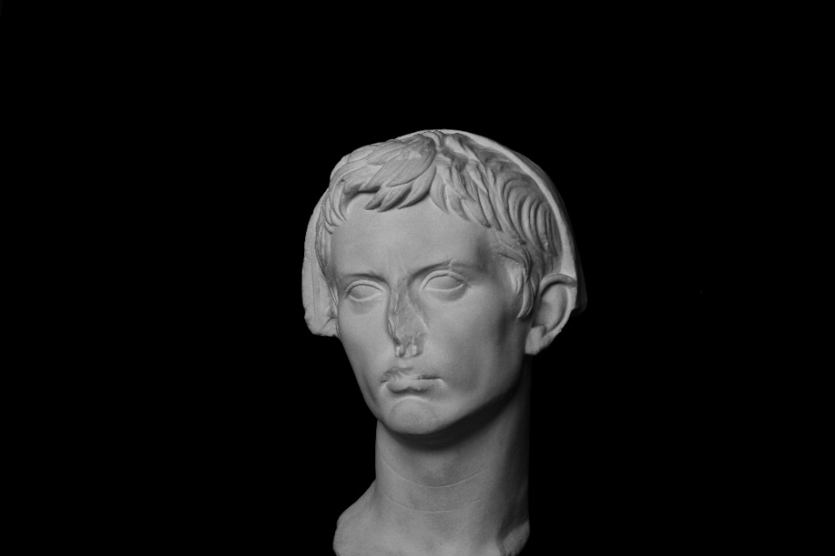
Data Acquisition - „Antikensammlung“ Erlangen
We started to scan busts of the famous emperor
  Up to now: 15 busts of the „Antikensammlung“ Erlangen
    Third largest collection of antiques in Bavaria
    Main focus on Greek and Roman historical artefacts
    450 plaster casts and 900 artefacts
  Goal: Gather data for conservation and analysis

Slide 5
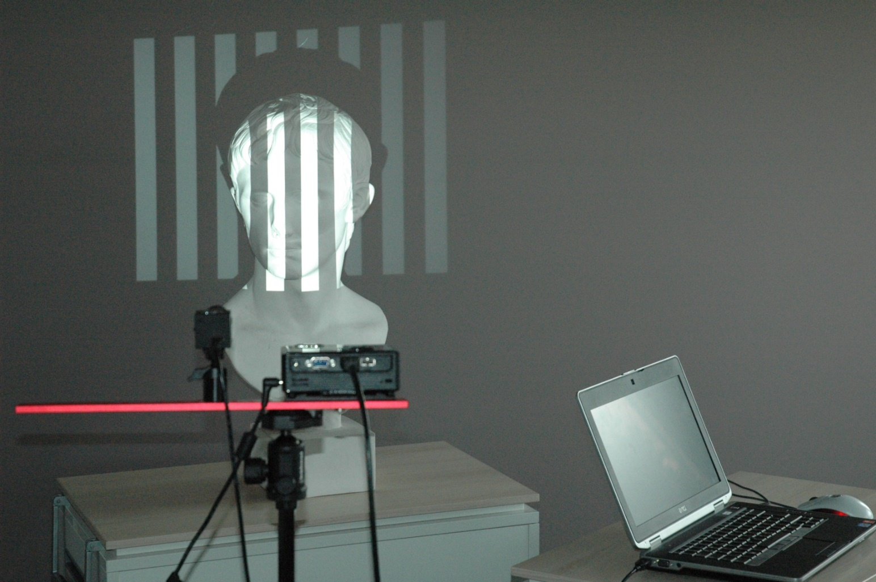
Data Acquisition - Setup
We use a portable structured light scanner
  DAVID SLS-1
  High quality reconstruction (sub-millimeter accuracy)
    Depends on size of scanned object

Slide 6
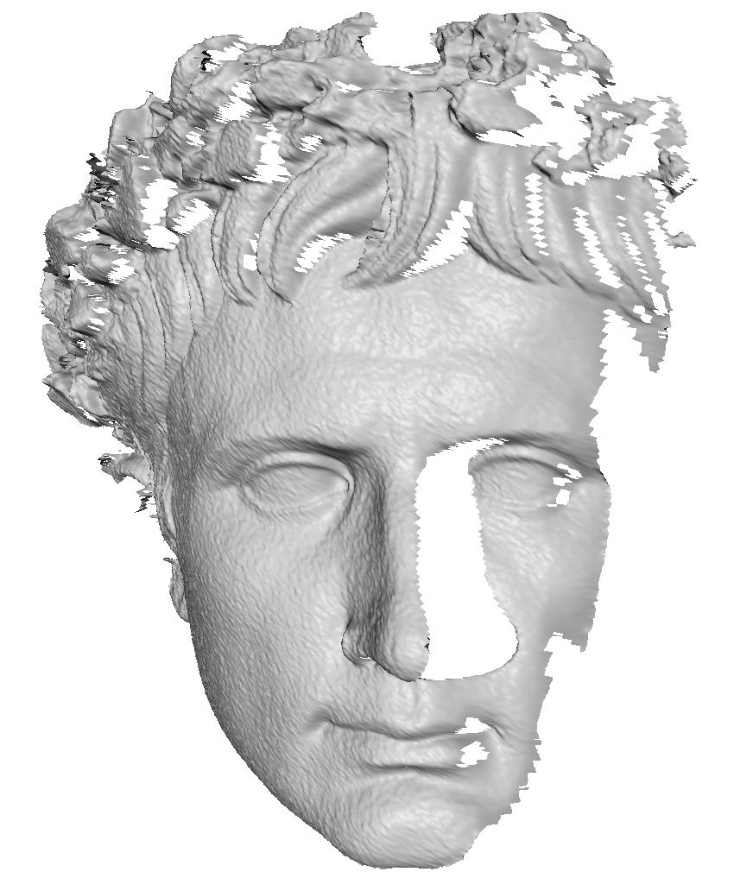
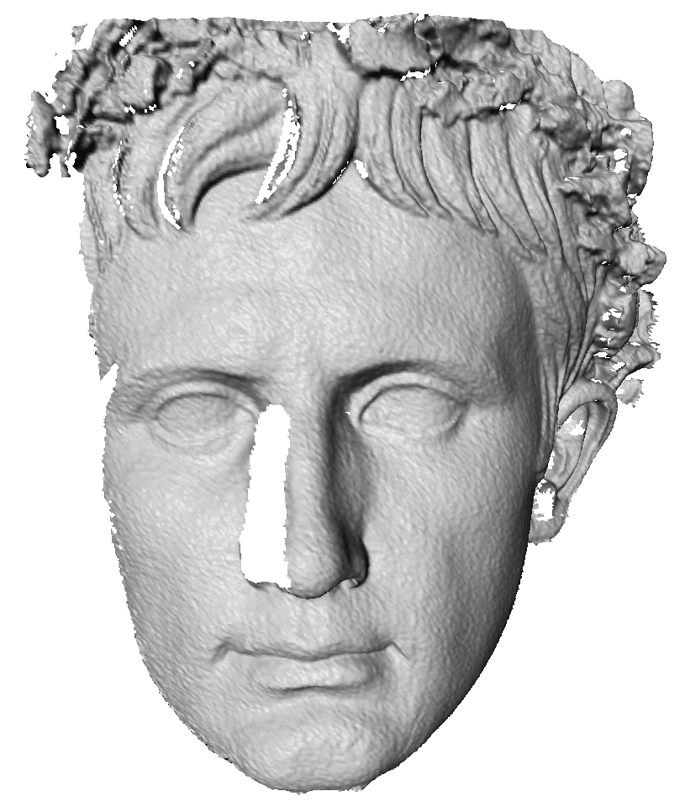

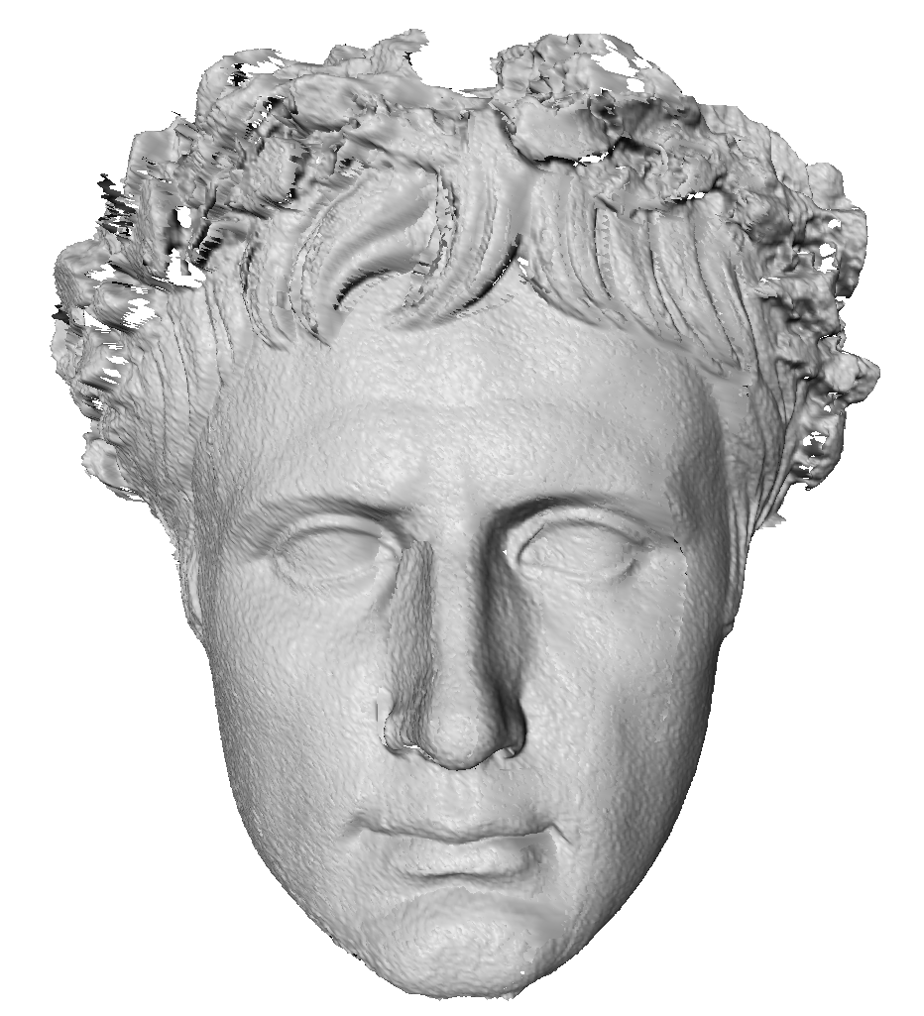
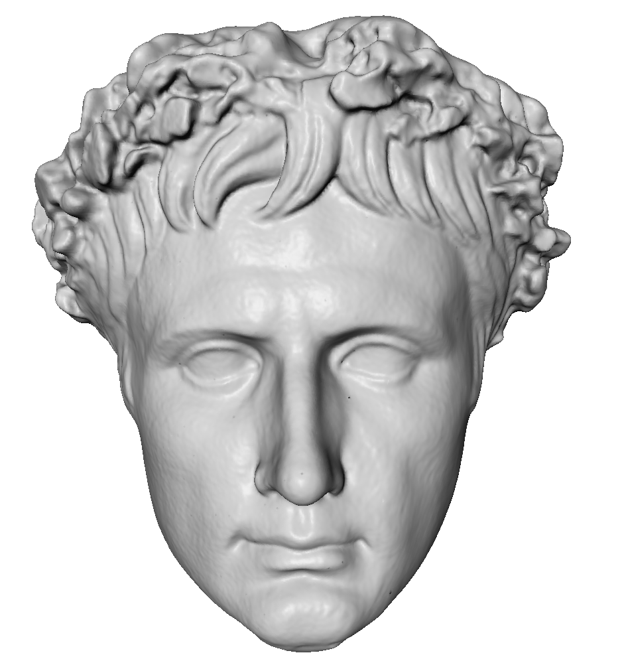
Data Reconstruction
Acquire multiple 3D-Scans
  Scans not in common coordinate frame
    Compute best rigid alignment
      [Besl92, Chen92]
  Single watertight surface by merging scans
    Poisson Surface Reconstruction
      [Kazhdan06]
  High-Quality 3D-Reconstruction

Slide 7
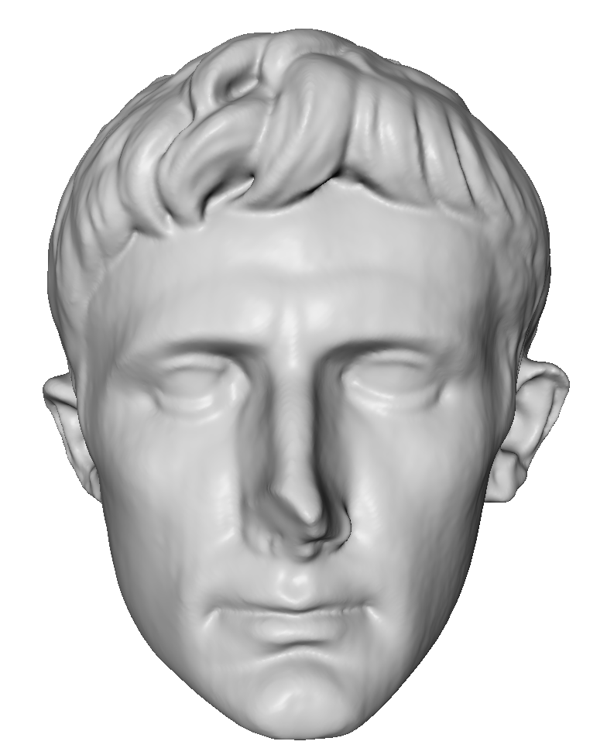
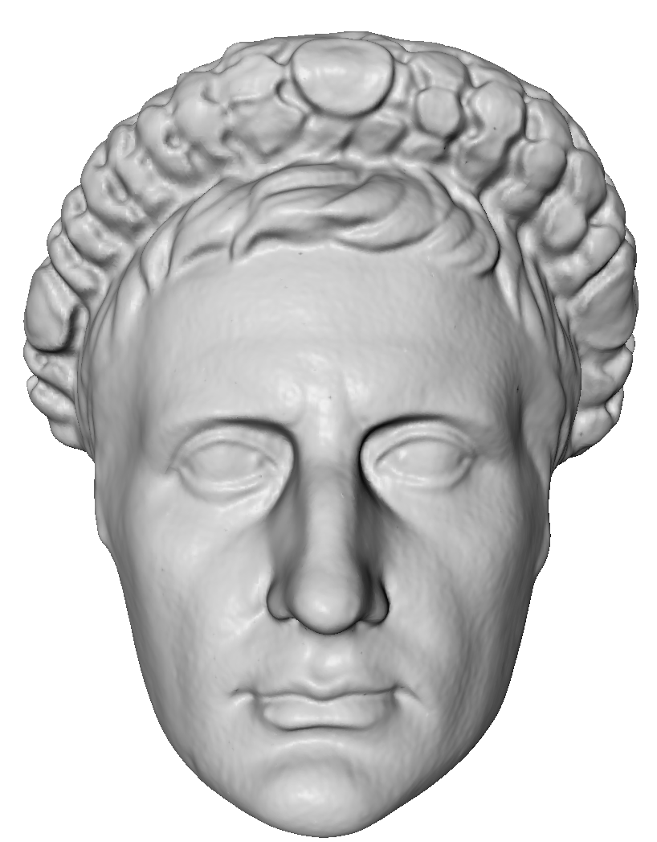
Data Reconstruction - Problem
3D-Scans have different topology
  No information about corresponding regions
    Which part of the model correspond to the nose, eyes, etc…
?
?

Slide 8
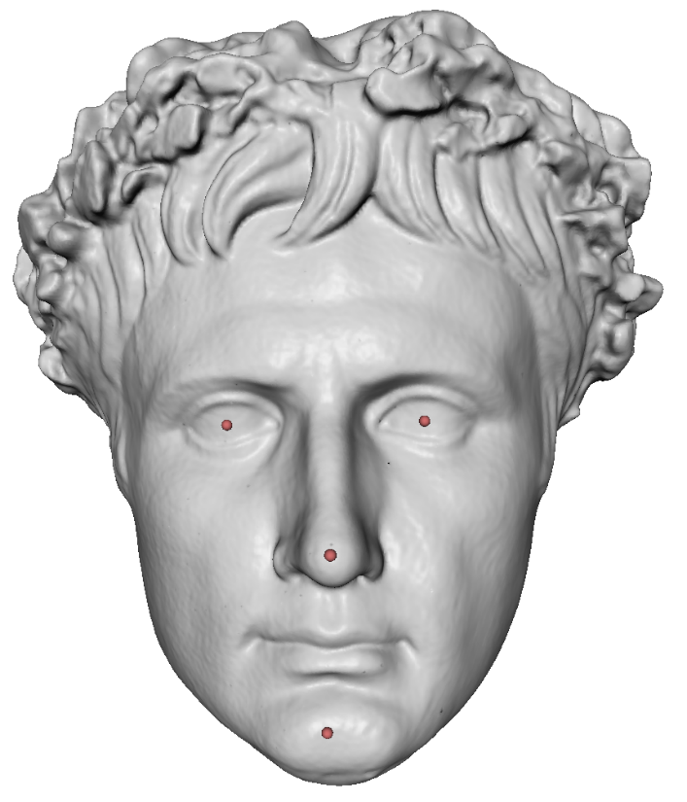
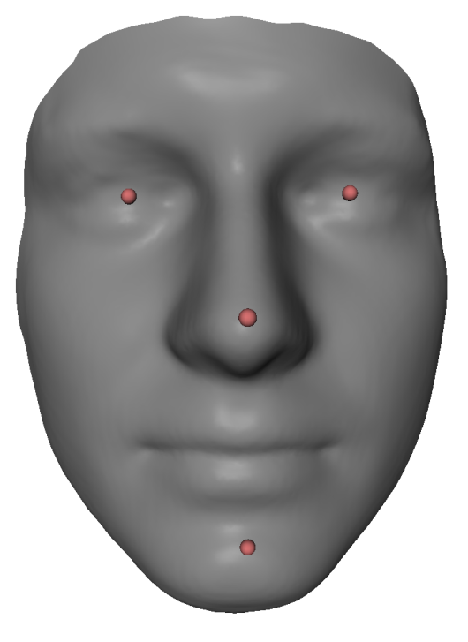
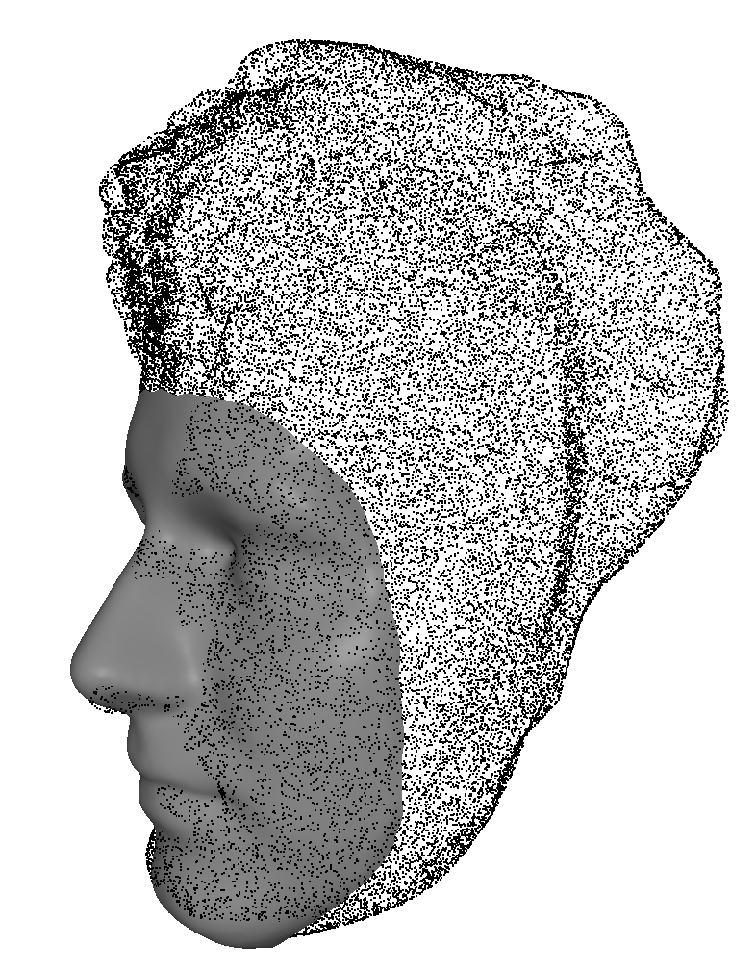
Rigid Registration
We start with a sparse set of manually placed correspondences
  Template mask and 3D-Scan
Compute best rigid transformation [Schönemann66] and scaling
  Convert mask and 3D-Scan to a common coordinate system:
    Same orientation, position and scale

Slide 9
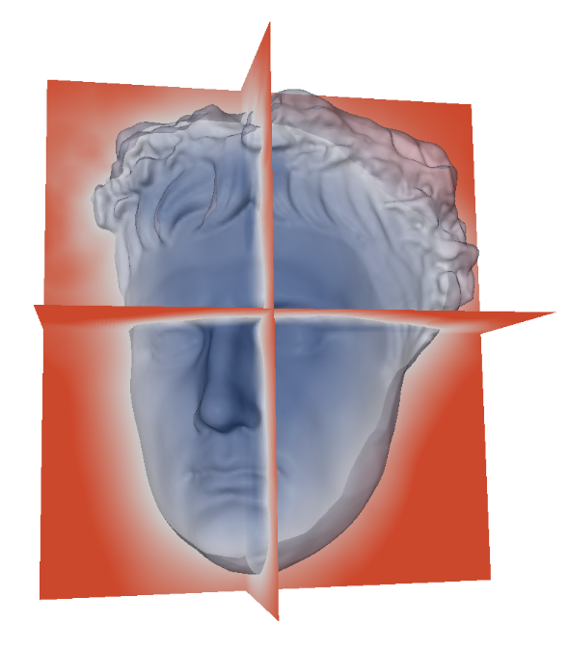
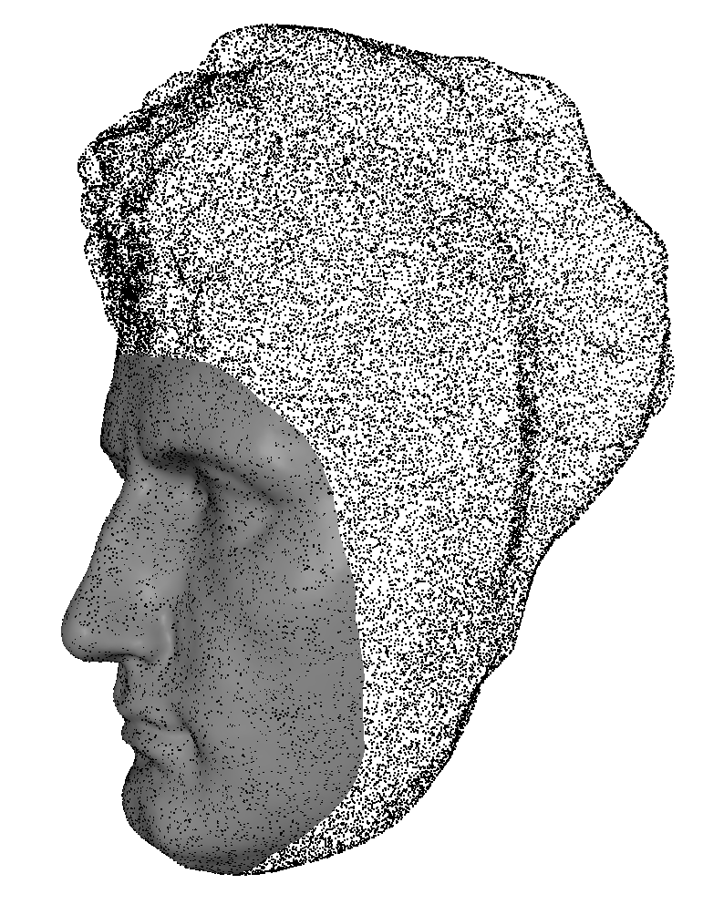
Non-Rigid Registration
Fit template mask using non-rigid surface registration
  Warp template such that it fits the input
    Two steps [Süßmuth10]:
      Coarse Alignment
        Deformation Graph [Sumner 07]
        Fit to implicit function of target
      Fine Alignment
        Optimize vertex positions directly
        ARAP Regularization [Sorkine07]
        Point-point distance measure

Slide 10
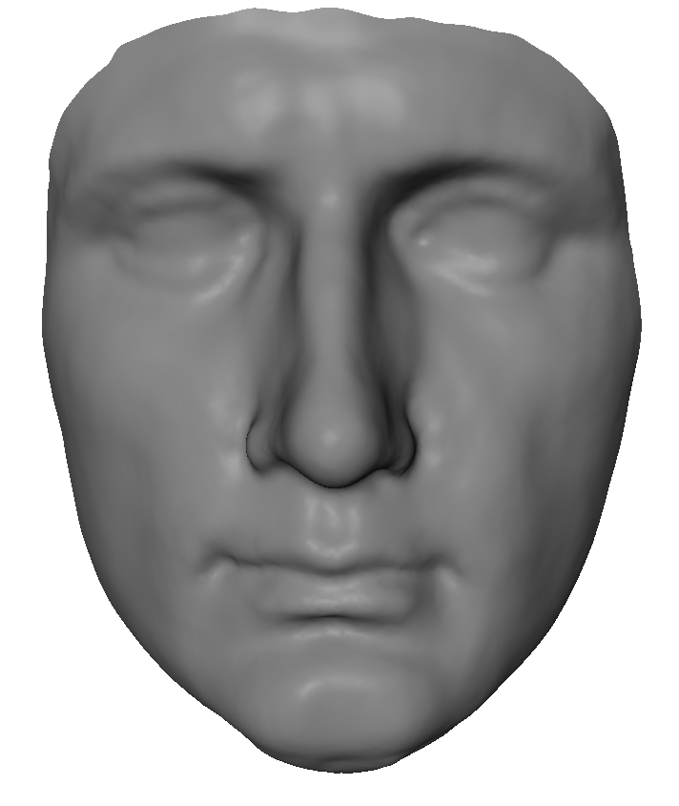
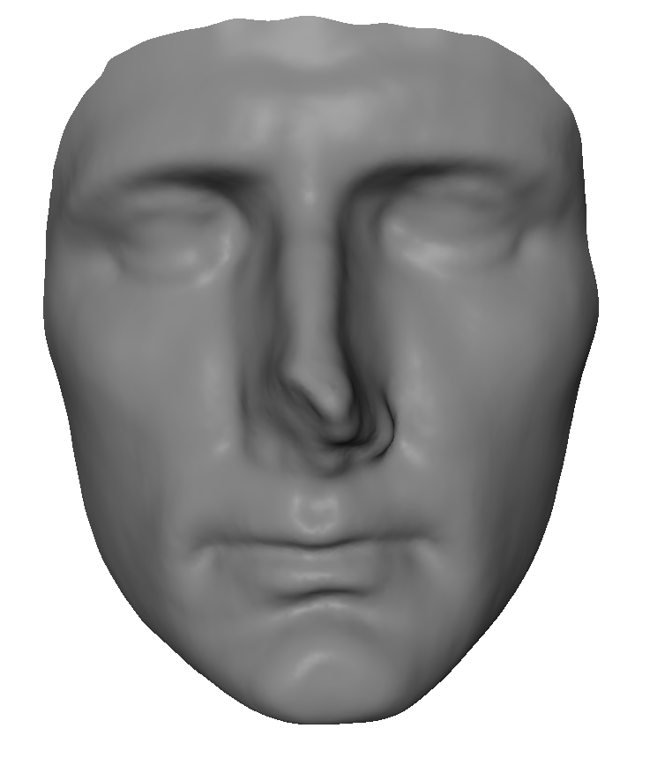
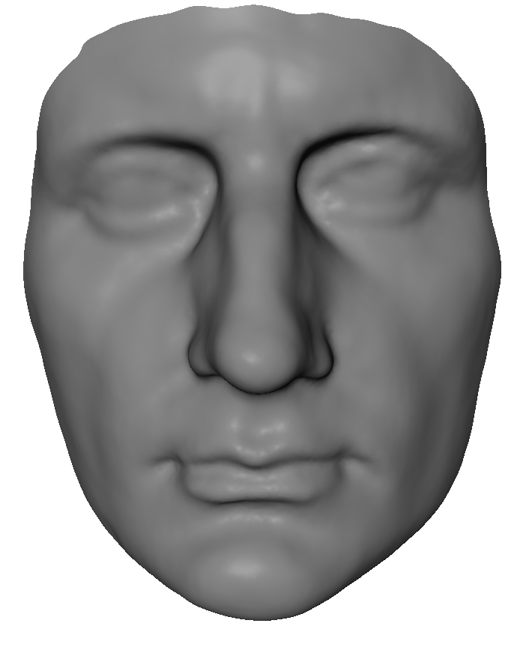
Non-Rigid Registration - Result
A set of masks with the same topology
  Dense point-to-point correspondences
    Basis for further processing:
      Statistical Model, Virtual Restoration, Animation Transplantation, …

Slide 11
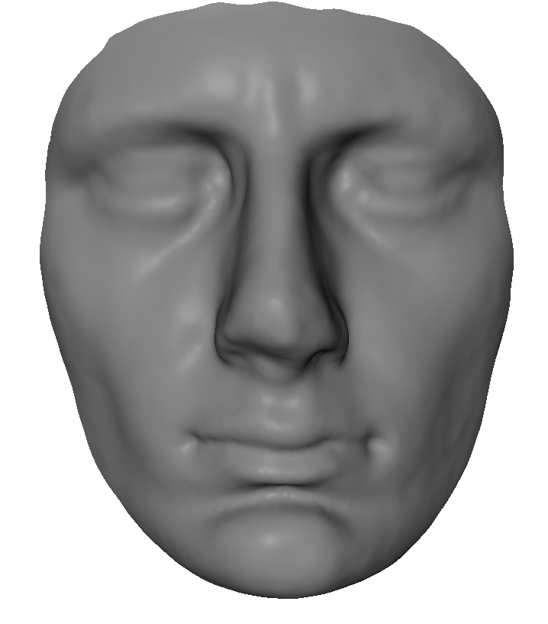
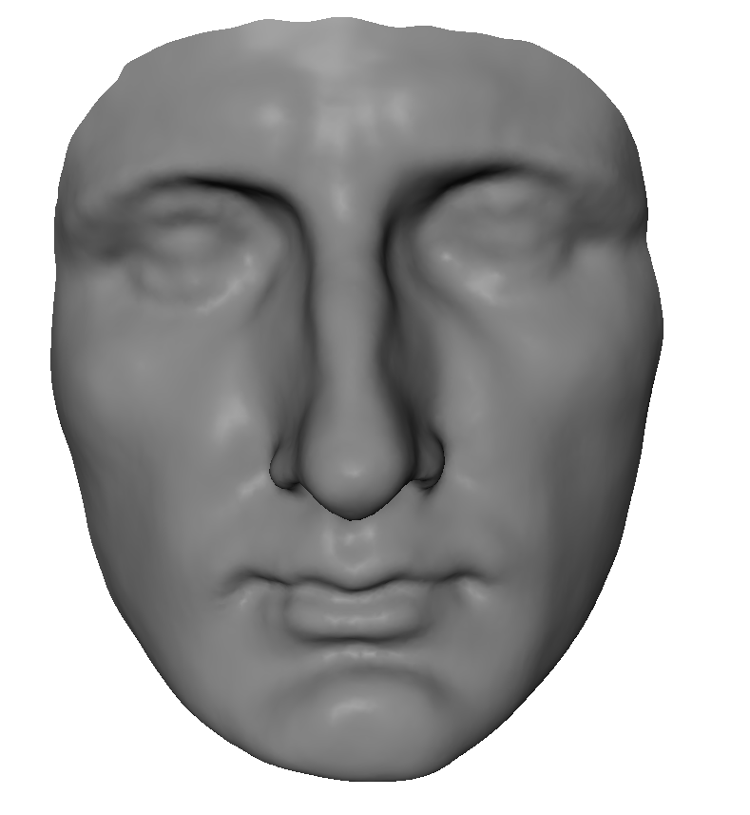
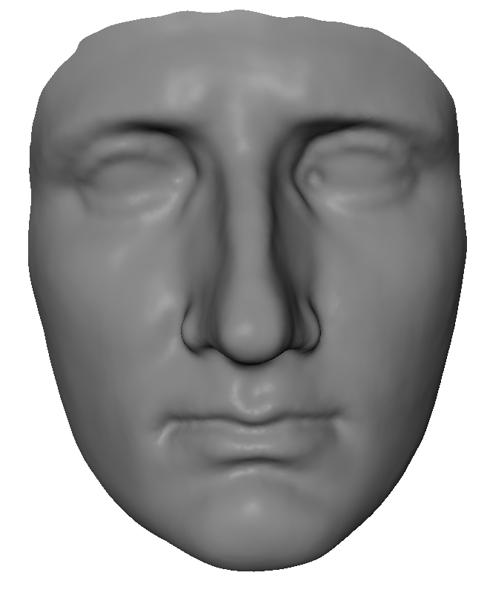
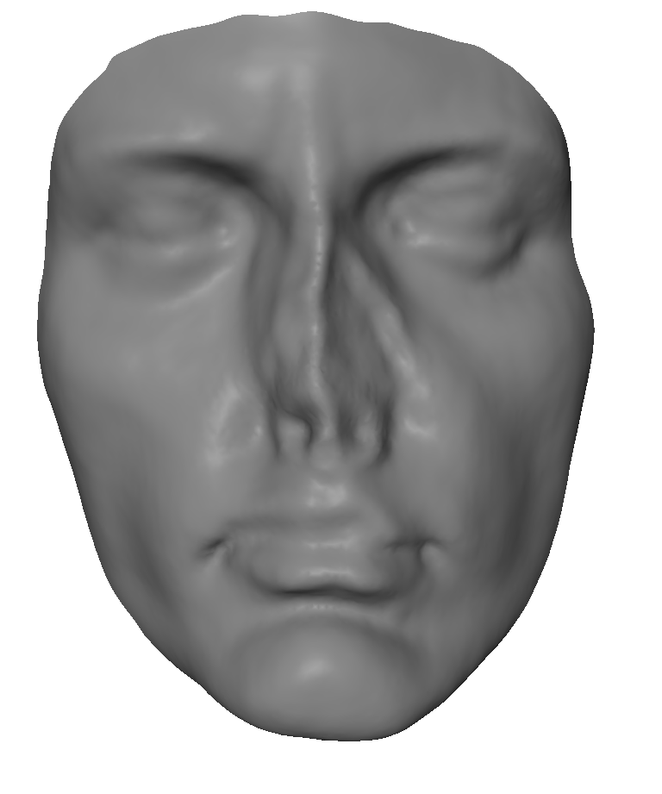
Statistical Face Model
Database of 3D-Scans:
  Dense point-to-point correspondences
  Same topology
Statistical Analysis
  Linear space spanned by scans
    [Blanz99, Blanz07]
    Dimensionality reduction (PCA)
    Visually explore most common variations

Slide 12
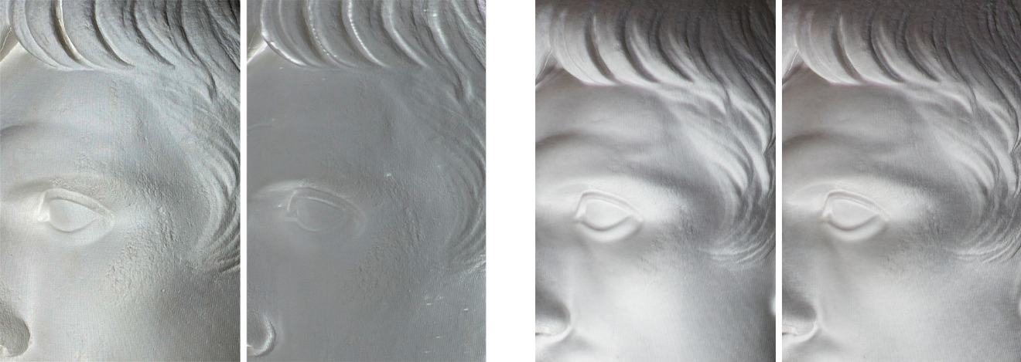
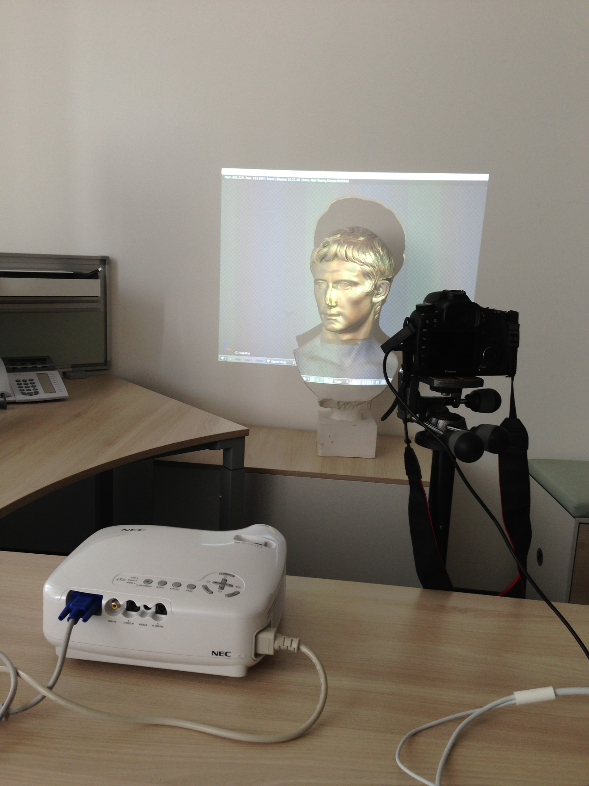
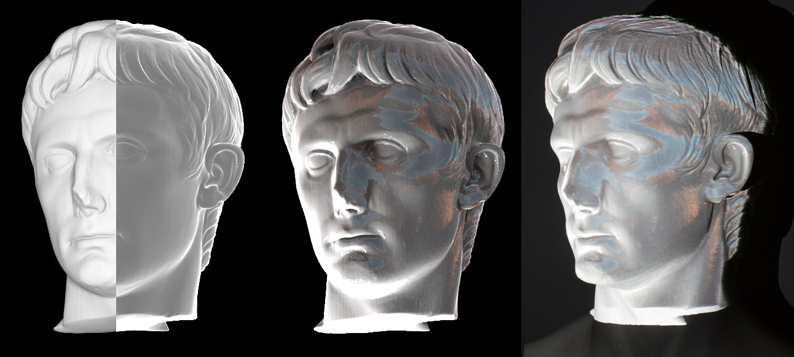
Applications - Virtual Painting
Modify virtual scene
  Material, Illumination, Paint
Generate Image
  Apply anti-shading
Project onto real world object
  Requires registration between virtual and real world objects

Slide 13

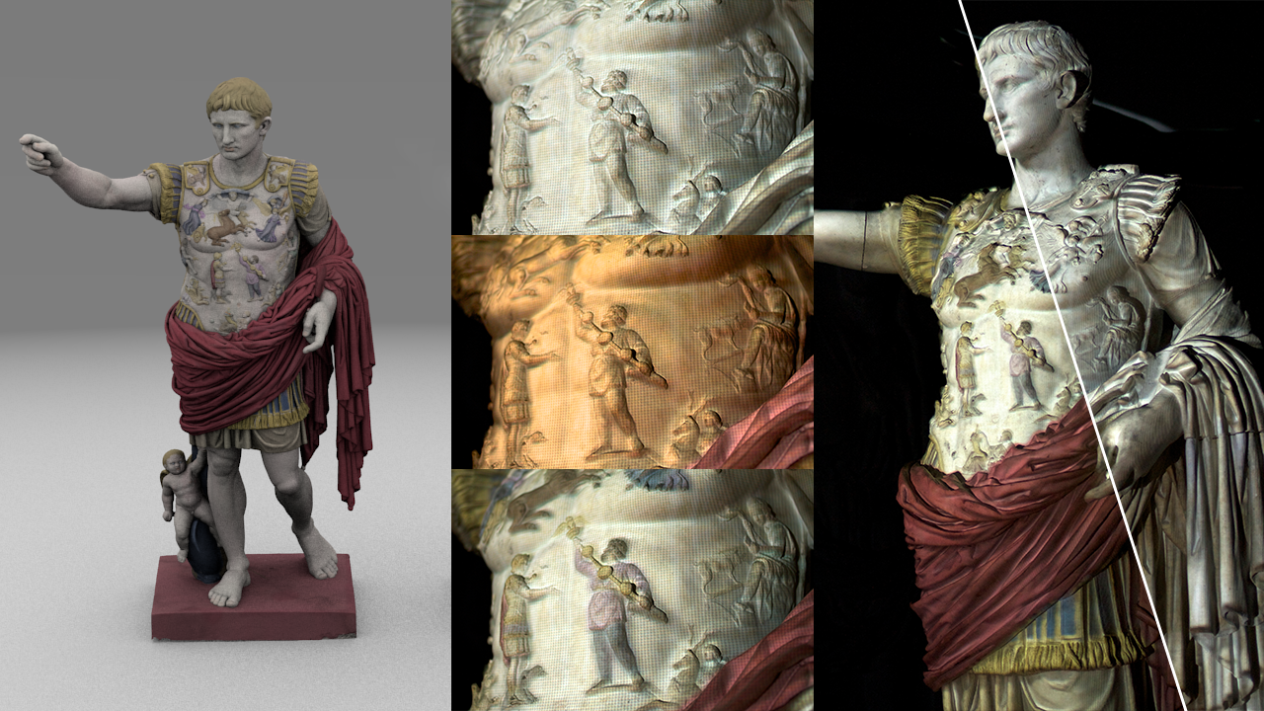
Applications - Virtual Painting

Slide 14
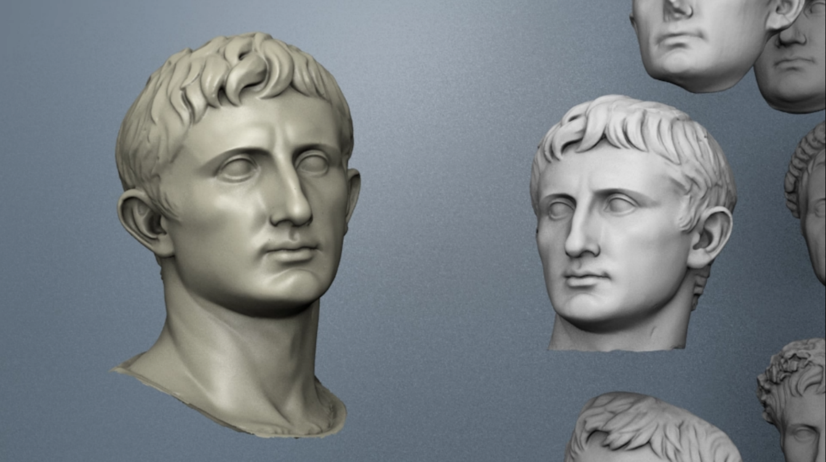
Applications - Visualizing Differences in Busts
Requires:
  Dense point-to-point mapping
  Morph in linear blend space
Seamless blending
  Visualize geometric differences
    Different archetypes
  VIDEO/DEMO

Slide 15
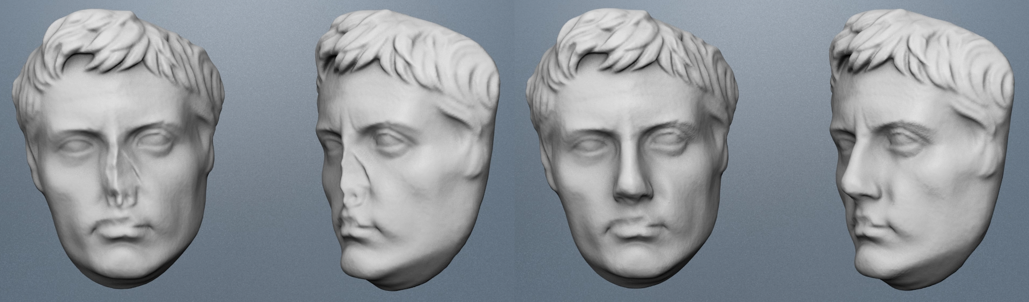
Applications - Virtual Restoration of Artefacts
Use dense inter surface mapping to transplant geometry between scans:
  Find best fitting artefact in linear blend space
  Transplant geometry in damaged regions
    VIDEO/DEMO

Slide 16
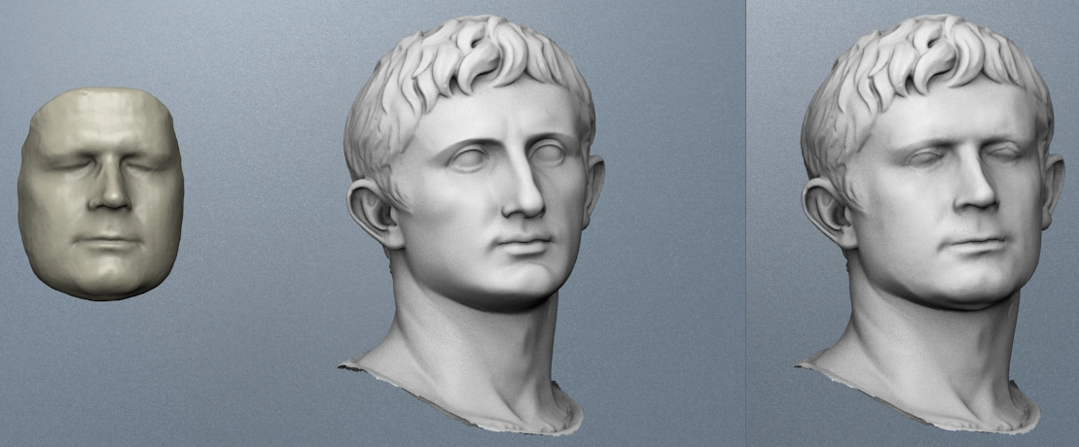
Applications - Augustification
Requires:
  Dense point-to-point mapping
Transfer intrinsic shape/identity of person to a statue
  Preserve statue-like appearance (Be your own emperor!)

Slide 17
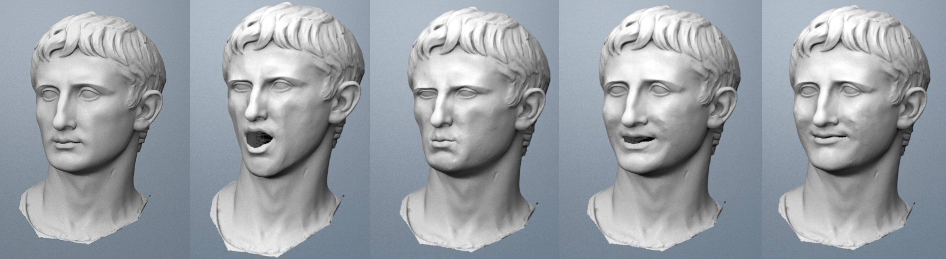
Applications - Animation Retargeting
Revive ancient artefacts:
  Capture animation with real-time 3D-Scanner
  Transfer animation to ancient artefact
    Preserve identity
    VIDEO/DEMO

Slide 18

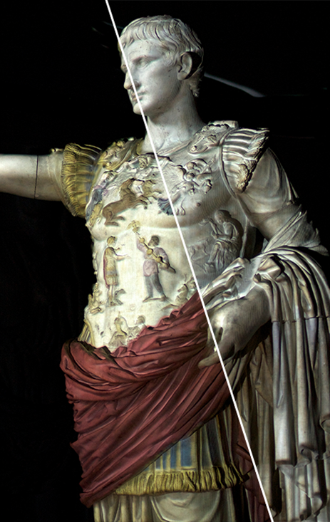
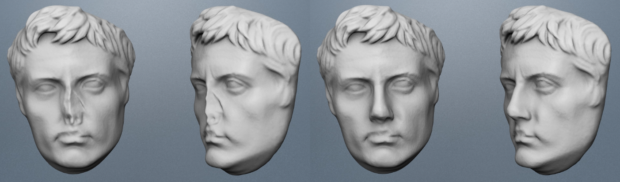
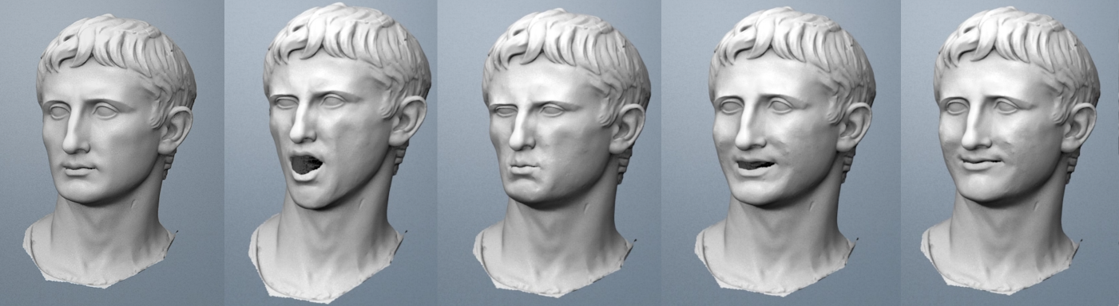
Conclusion/Future Work
Foundation for applications:
  Dense inter surface mapping
  Robust Non-Rigid Registration
Applications demonstrate:
  Symbiosis of different disciplines
  Humanities and Computer Graphics
Explore further applications
  Present to larger audiences

