Slide 1
Mo²Cap²: Real-time Mobile 3D Motion
Capture with a Cap-mounted Fisheye Camera
Paper Session: 11
Weipeng Xu ¹, Avishek Chatterjee ¹, Michael Zollhöfer ², Helge Rhodin ³,
Pascal Fua ³, Hans-Peter Seidel ¹, Christian Theobalt ¹
¹ Max-Planck-Institute for Informatics, ² Stanford University, ³ EPFL
Journal Paper

Slide 2
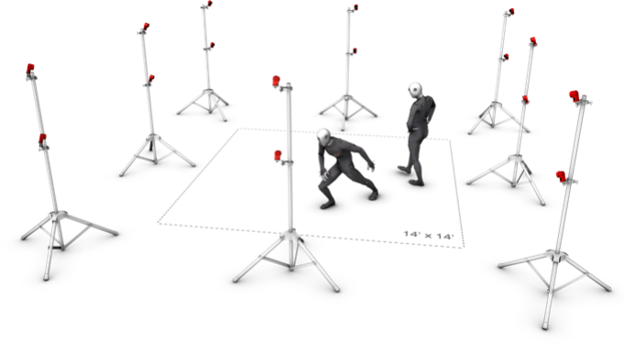
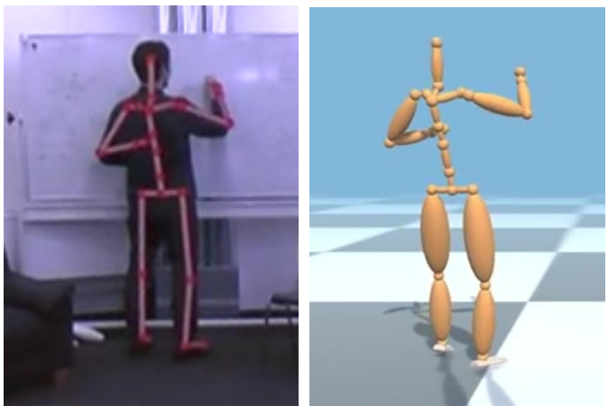
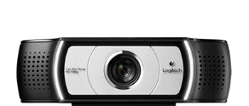
Problem & Motivation
Outside-in mocap: limited recording volume, space requirement
Multi-camera mocap
Monocular mocap
[Mehta et al. 2017]
[Gall et al. 2010], [Joo et al. 2015], [Sigal et al. 2010], [Stoll et al. 2011], [Moeslund et al. 2011], [Pavlakos et al. 2016], [Tekin et al. 2016], [Yasin et al. 2016], [Wei & Chai 2010], [Rogez et al. 2017] …

Slide 3
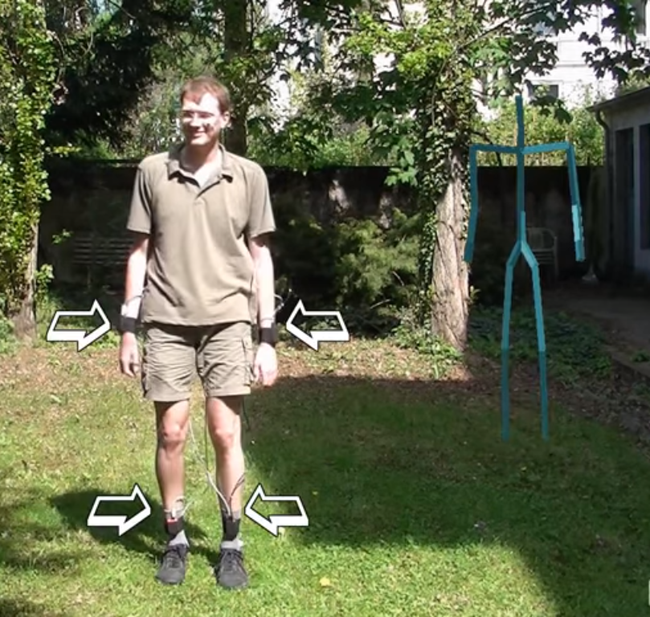
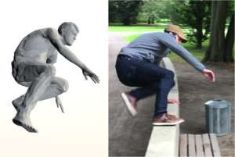
Related Work
Boby-worn motion sensors (IMU)
[Tautges et al. 2011]
[von Marcard et al. 2017]
[Roetenberg et al. 2007], [Vlasic et al. 2007], [Marcard et al. 2016], [Andrews et al. 2016] ...

Slide 4
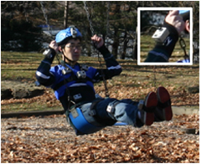
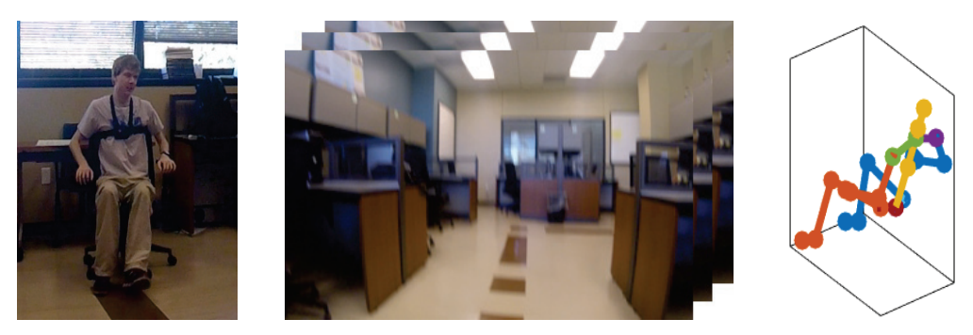
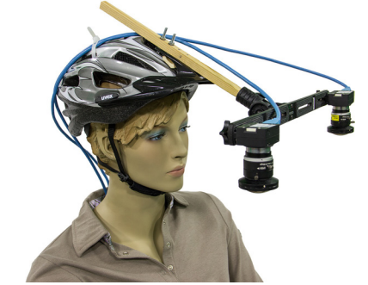
Related Work
Body-mounted camera systems
[Shiratori et al. 2011]
[Jiang et al. 2017]
[Rhodin et al. 2016]
Inside-out
Inside-in

Slide 5
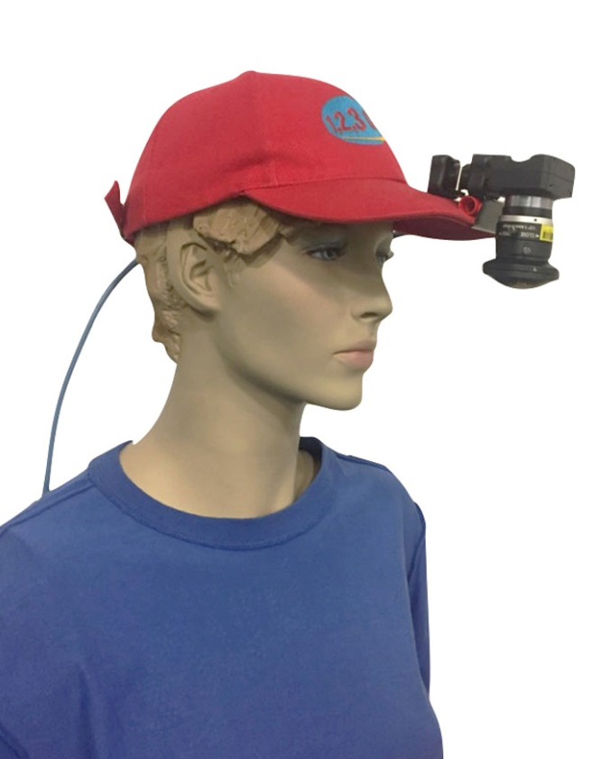
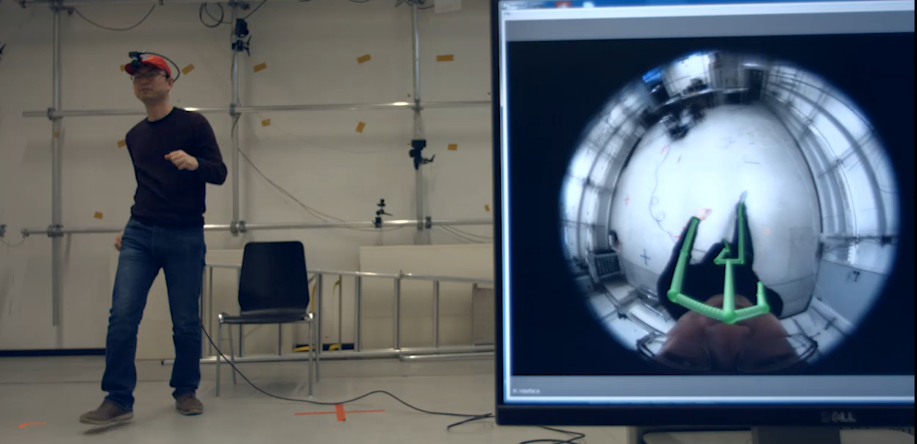
Our Approach
Lightweight, real-time mobile mocap with a cap-mounted fisheye camera
Live demo @ 60 FPS

Slide 6

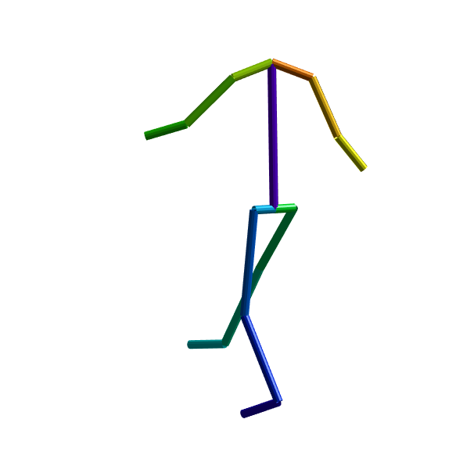
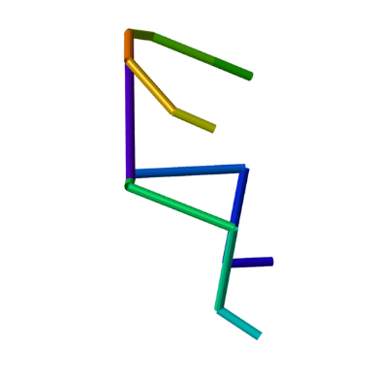
CNN-based 3D Pose Estimation
Challenges:
Strong radial distortion
Strong perspective distortion
Direct 3D pose regression does not yield good results
CNN

Slide 7
Disentangled CNN Architecture
3D = 2D + depth

Slide 8
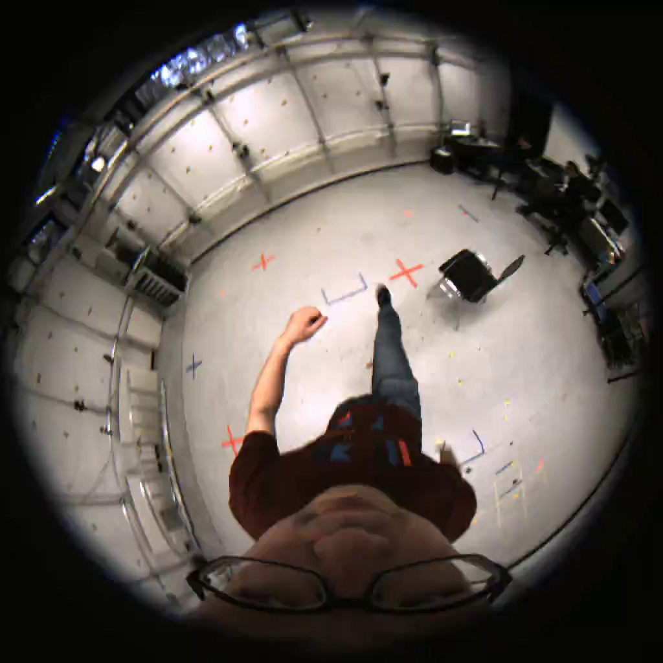
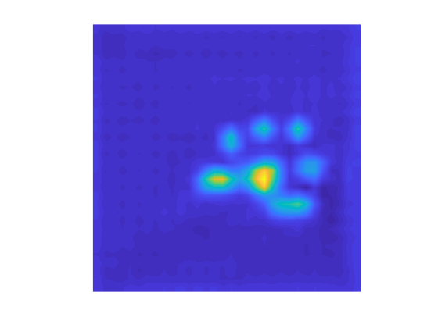



Disentangled CNN Architecture
2D pose
Fisheye camera
$$(u,v)$$
$$v$$
…
$$u$$

Slide 9
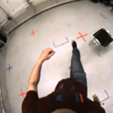
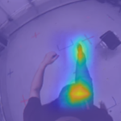
Disentangled CNN Architecture
2D pose
Fisheye camera
$$(u,v)$$
+
$$v$$
…
$$u$$
zoom-in
…

Slide 10

Disentangled CNN Architecture
2D pose
Fisheye camera
$$(u,v)$$
+
$$v$$
…
$$u$$
zoom-in
…
joint-to-camera distance
d

Slide 11
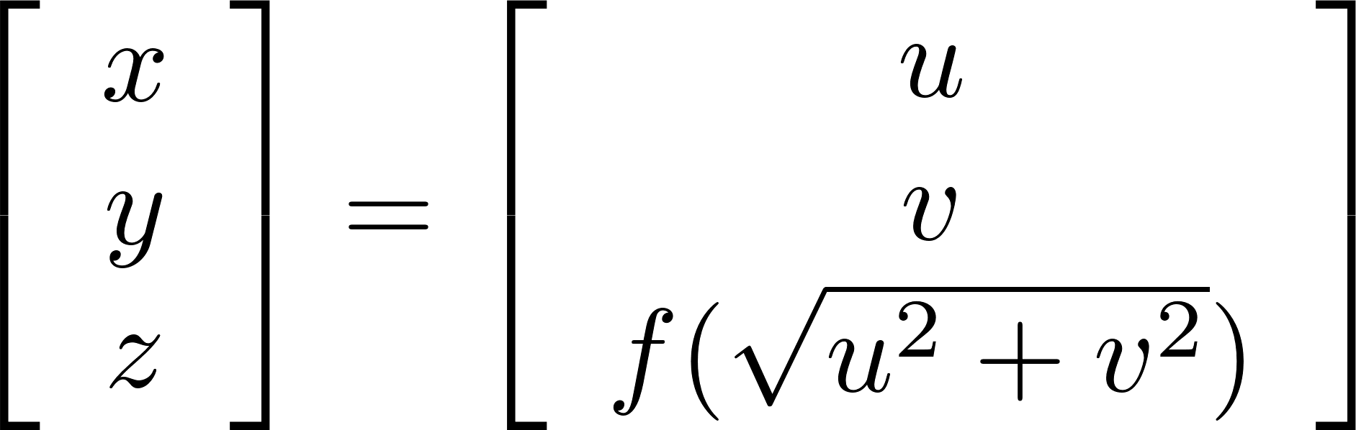
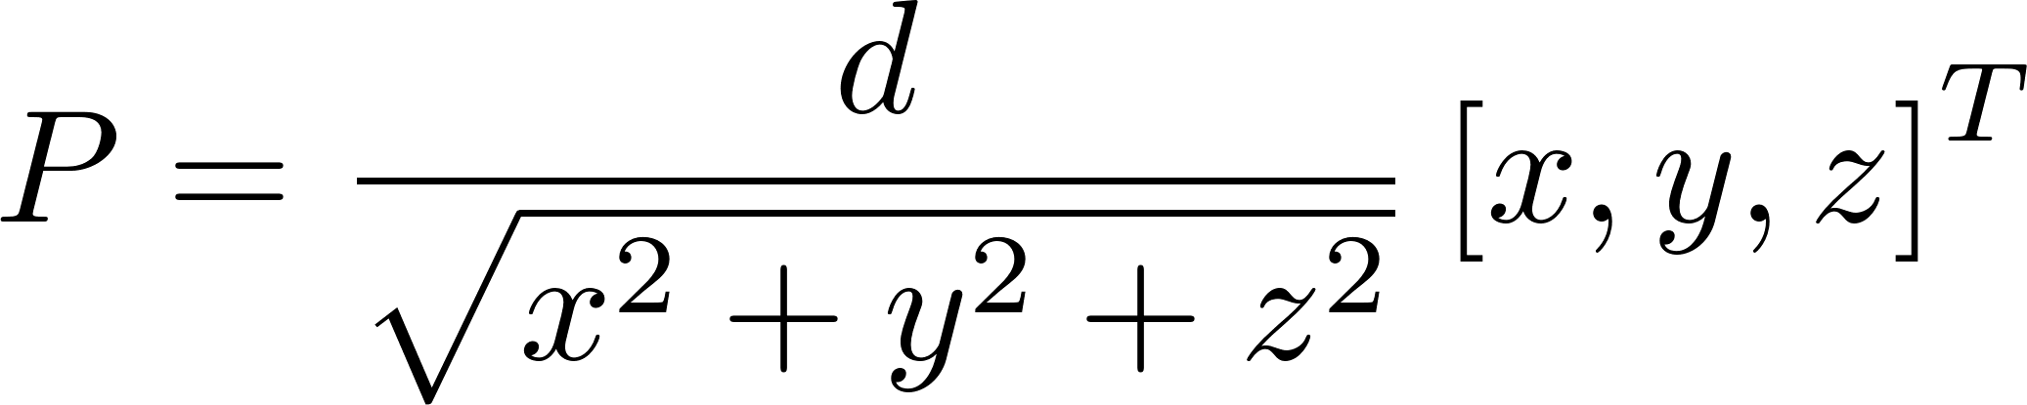



Disentangled CNN Architecture
2D pose
Fisheye camera
$$(u,v)$$
+
$$v$$
…
$$u$$
zoom-in
…
3D joint position
joint-to-camera distance
d

Slide 12
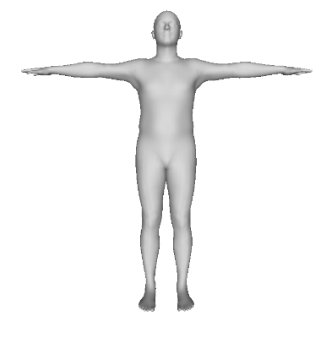
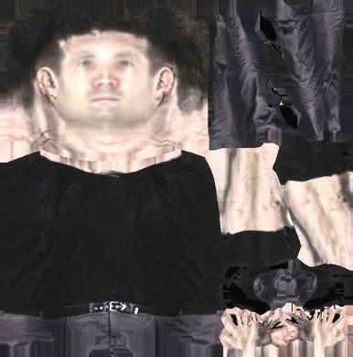
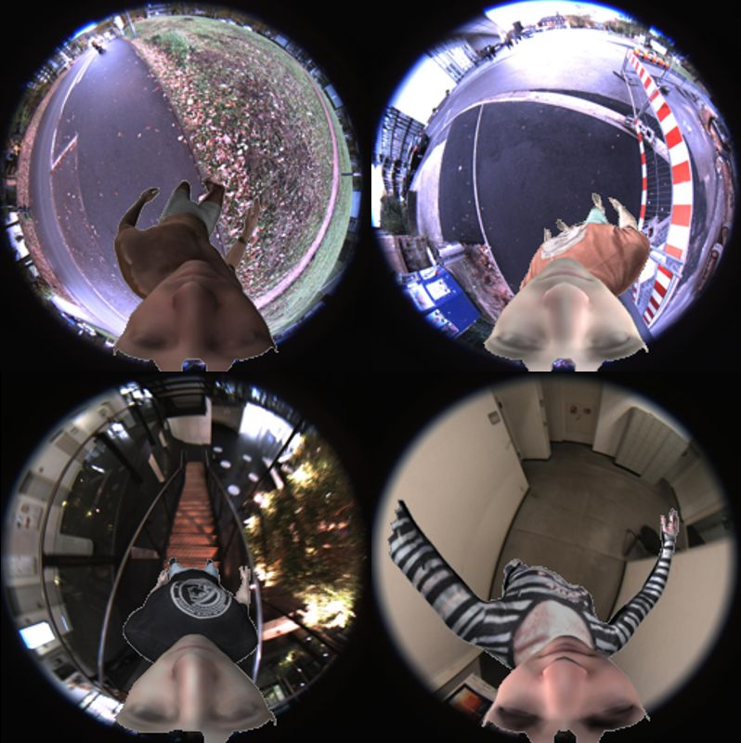
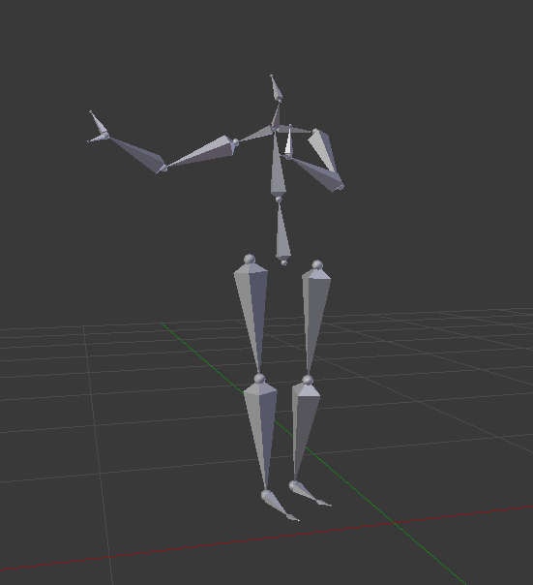
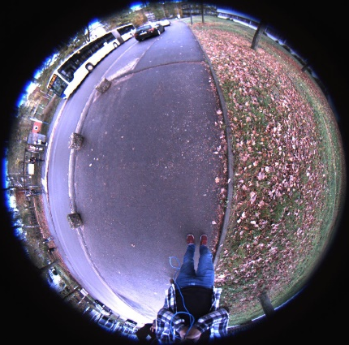
Training Data
SMPL model
texture
mocap data
background
Our synthetic training data

Slide 13
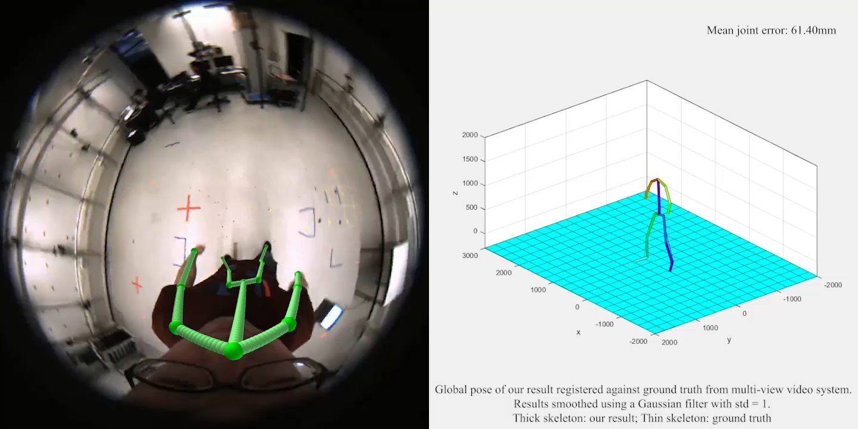
Results

Slide 14
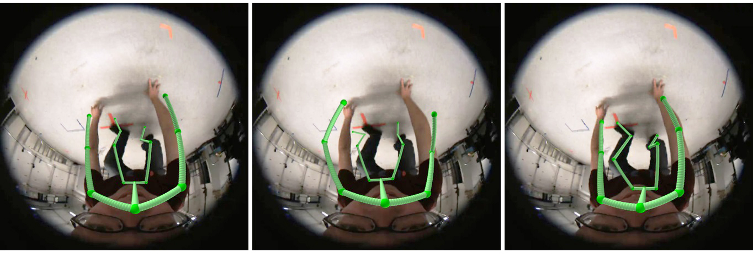
Comparison
Direct 3D pose regression
using fully connected layer
Direct 3D pose regression
using fully conv net
Ours
[3DV’17]
[VNect]

Slide 15
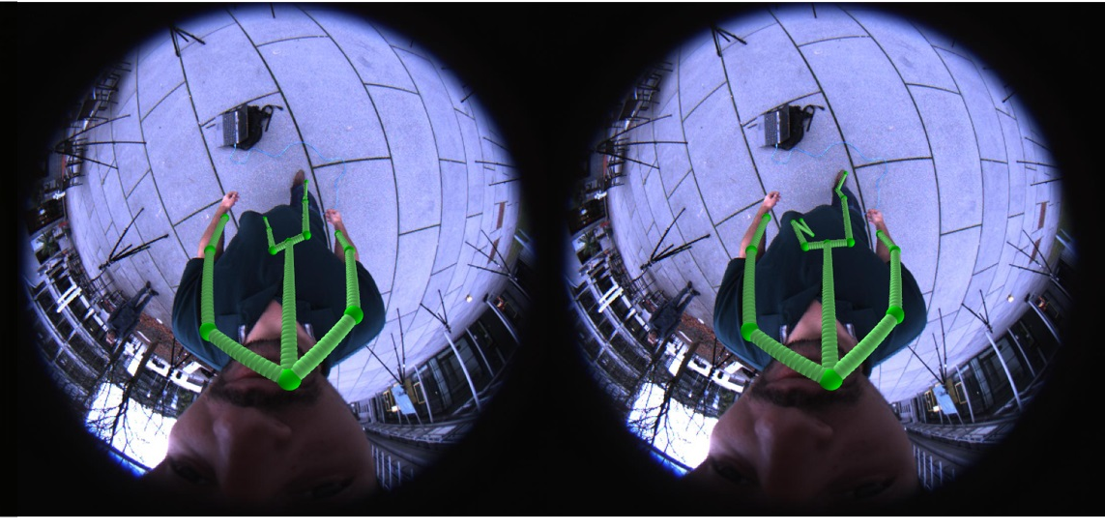
Comparison
Ours w/o zoom-in
Ours

Slide 16
Comparison
3D pose estimation comparison in mean joint position error
Method | Indoor MJE (mm) | Outdoor MJE (mm)
3DV’17 | 76.2 | 92.4
VNect | 97.8 | 113.7
Ours w/o zoom | 70.1 | 87.3
Ours | 61.3 | 80.6
Direct 3D
2D+depth
2D+depth+zoom

Slide 17
Comparison
3D pose estimation comparison in mean joint position error
Method | Indoor MJE (mm) | Outdoor MJE (mm)
3DV’17 | 76.2 | 92.4
VNect | 97.8 | 113.7
Ours w/o zoom | 70.1 | 87.3
Ours | 61.3 | 80.6
Direct 3D
2D+depth
2D+depth+zoom

Slide 18
Comparison
3D pose estimation comparison in mean joint position error
Method | Indoor MJE (mm) | Outdoor MJE (mm)
3DV’17 | 76.2 | 92.4
VNect | 97.8 | 113.7
Ours w/o zoom | 70.1 | 87.3
Ours | 61.3 | 80.6
Direct 3D
2D+depth
2D+depth+zoom

Slide 19
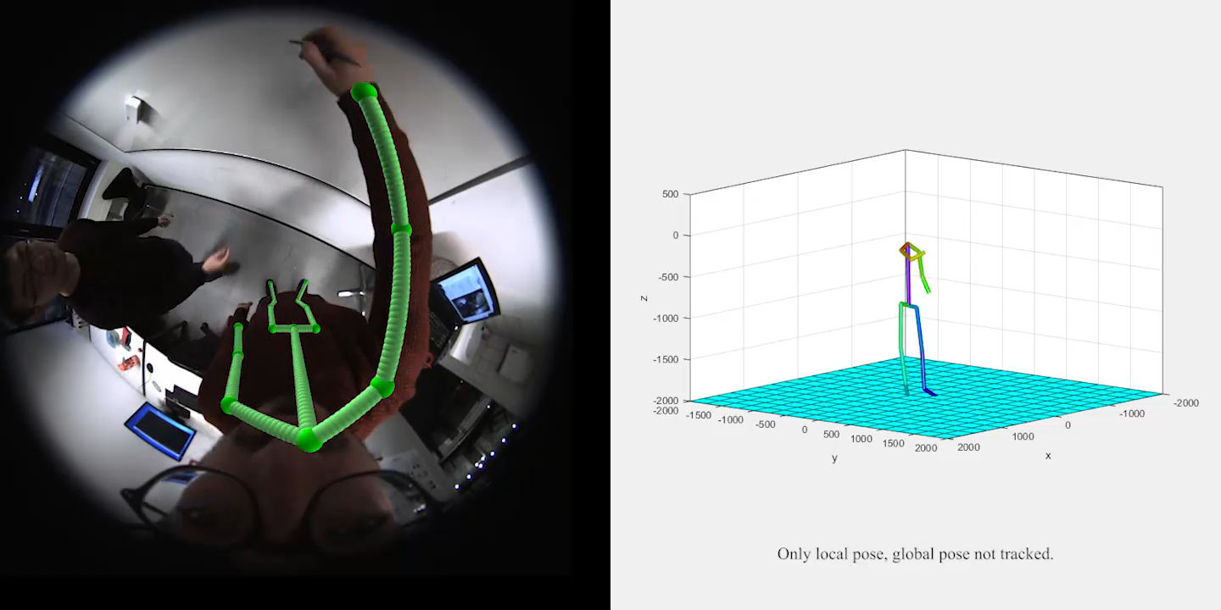
Results on Daily Activities: Office

Slide 20
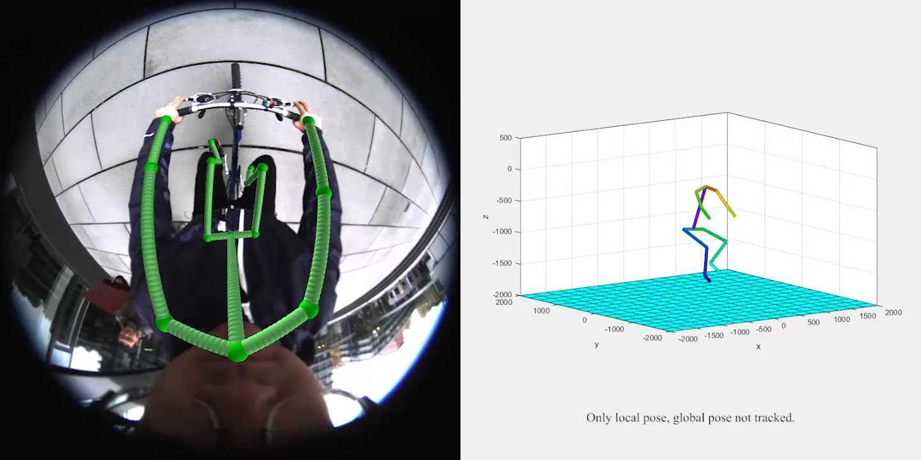
Results on Daily Activities: Bicycling

Slide 21
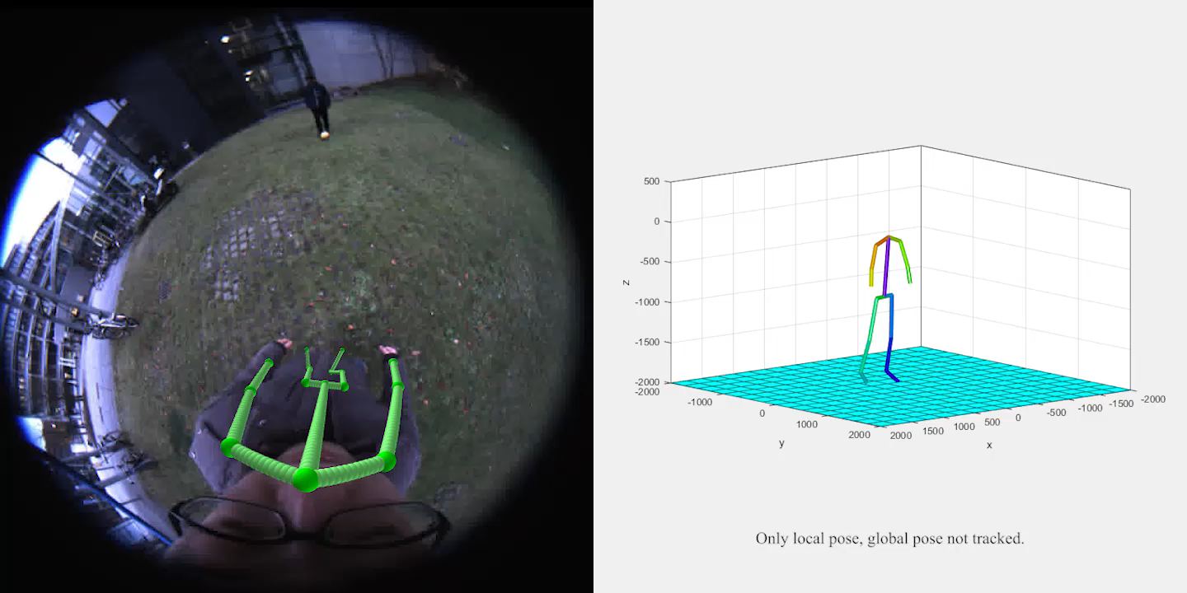
Results on Daily Activities: Sports

Slide 22
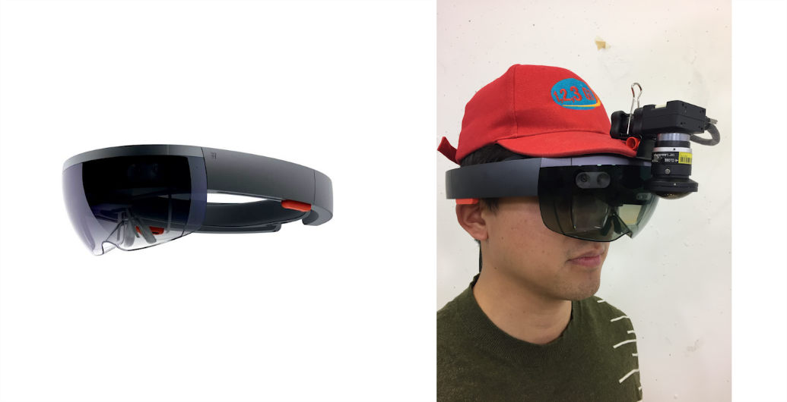
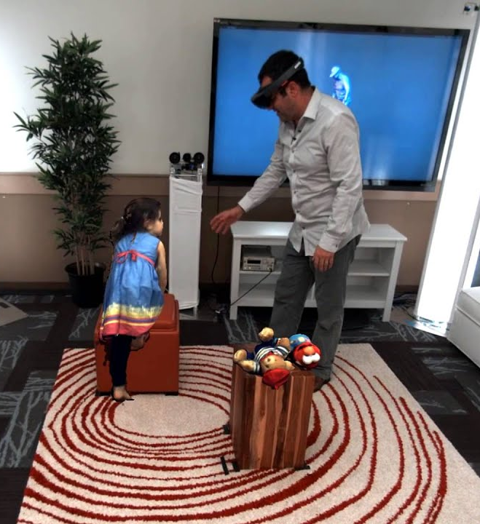
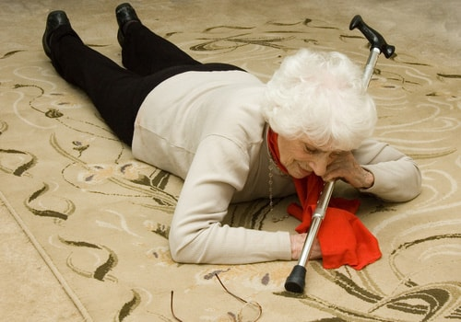
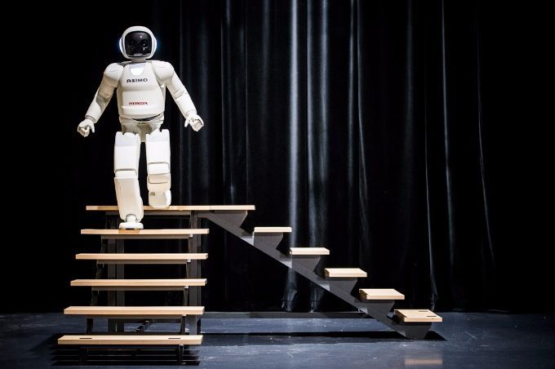
Conclusion & Potential Applications
VR/AR:
Natural HCI with full body
Perception of full body
Telepresence - Holoportation
…
Health-care:
Fall detection
Sports training
…
Robotics:
Training robots
Scene understanding
…

Slide 23
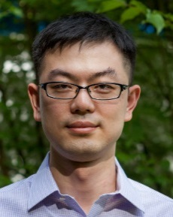

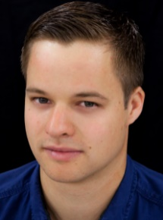
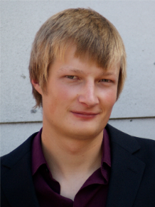
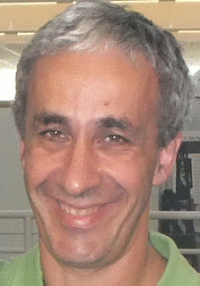
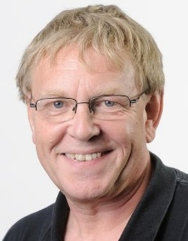






Thanks!
Weipeng
Xu
Avishek Chatterjee
Michael Zollhöfer
Helge
Rhodin
Pascal
Fua
Hans-Peter
Seidel
Christian
Theobalt
Supported by ERC Starting Grant CapReal

Slide 24




Mo²Cap²: Real-time Mobile 3D Motion
Capture with a Cap-mounted Fisheye Camera
Dataset available →

